Slide 1


Telecom Customer Churn
Group 7
Mr. Saurabh Nimje
Mr. Anish Chichad
Mr. Adesh Jadhav
Mr. Shreyash Patil
Mr. Abhijeet N. Patil

Slide 2
Business Objective
Customer churn is a big problem for telecommunications companies. Indeed, their annual churn rates are usually higher than 10%. For that reason, they develop strategies to keep as many clients as possible.
The goal of the project is to model churn probability, conditioned on the customer features.
To predict the customer churn.
Highlight main variables/factors influencing customer churn.
This is a classification project since the variable to be predicted is binary (churn or loyal customer).

Slide 3
Data Set Details: Churn.csv
Each row corresponds to data of a client (for example: type of plan, the minutes they have talked, or the charges they pay every month.
The target variable “churn” indicates whether a customer is churned out or not.

Slide 4
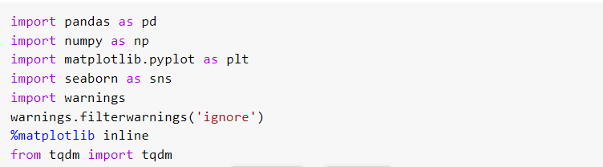
Import Libraries

Slide 5
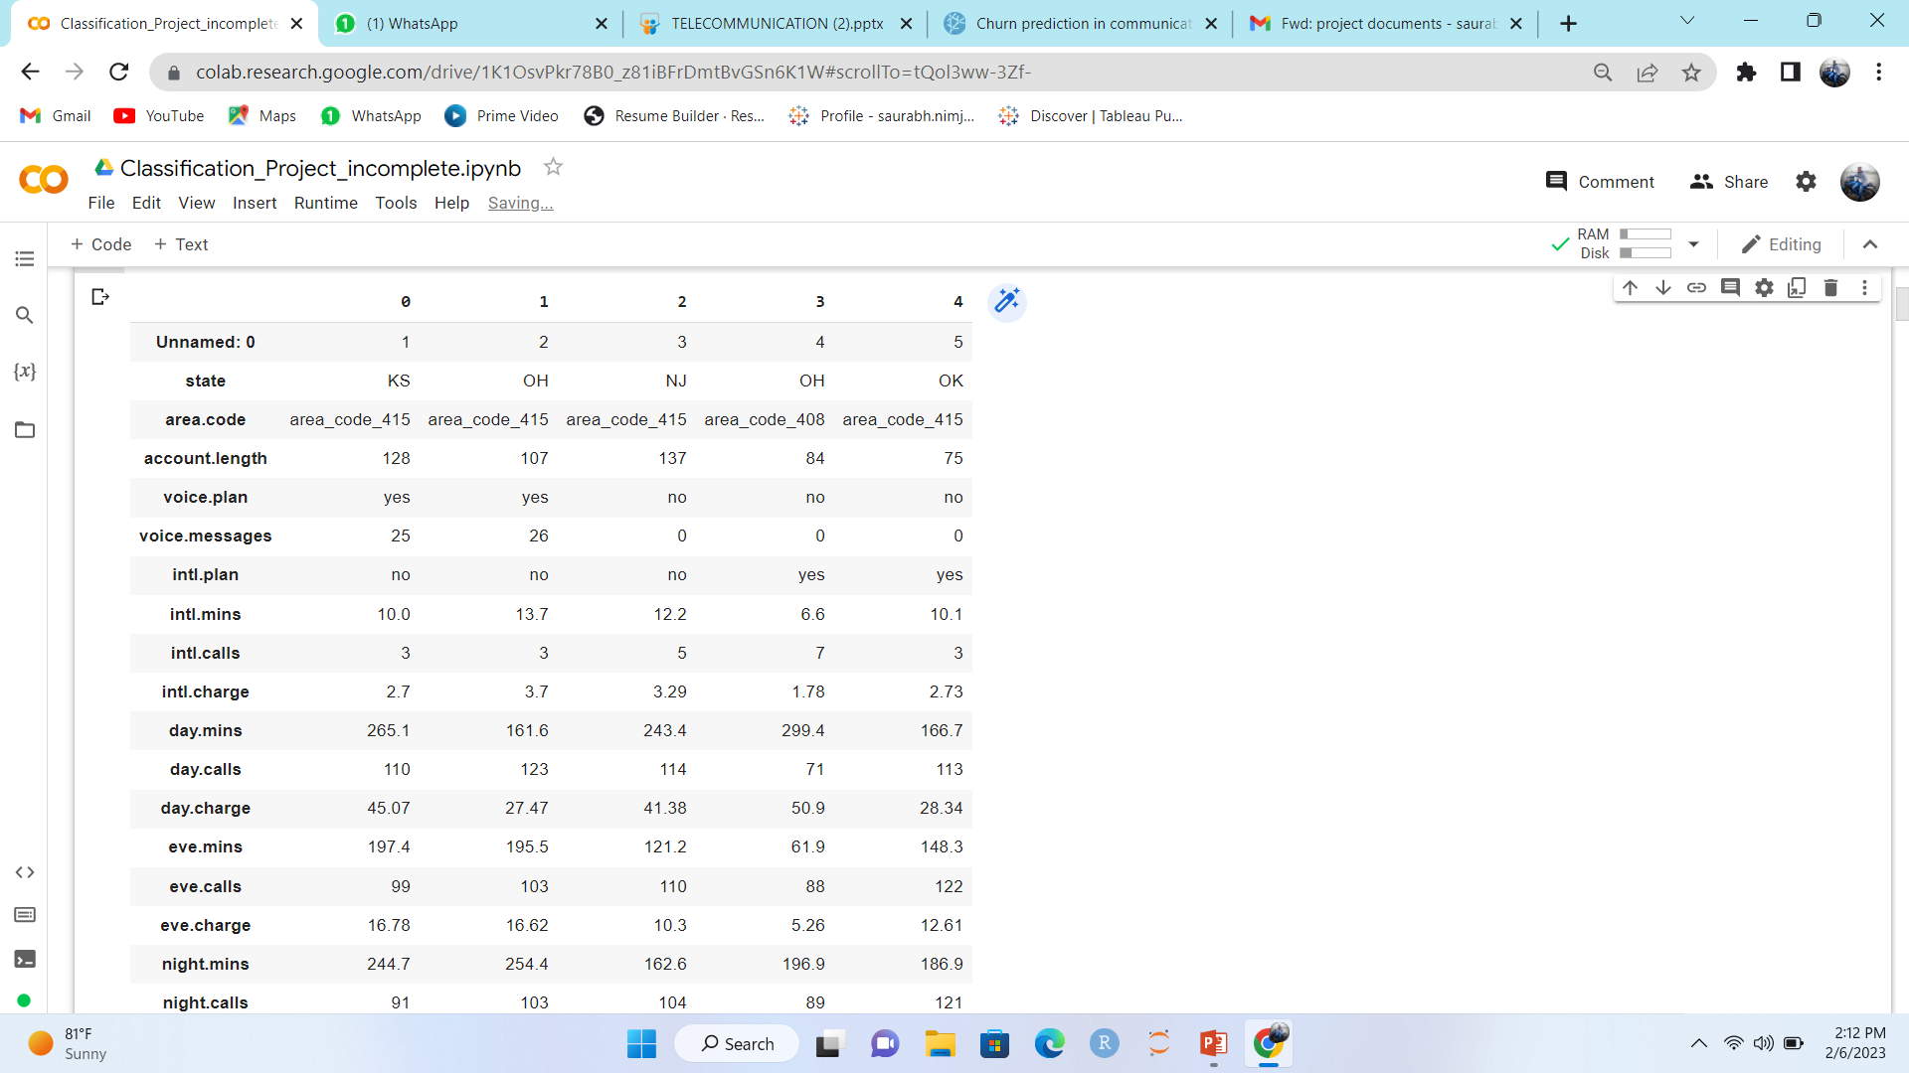
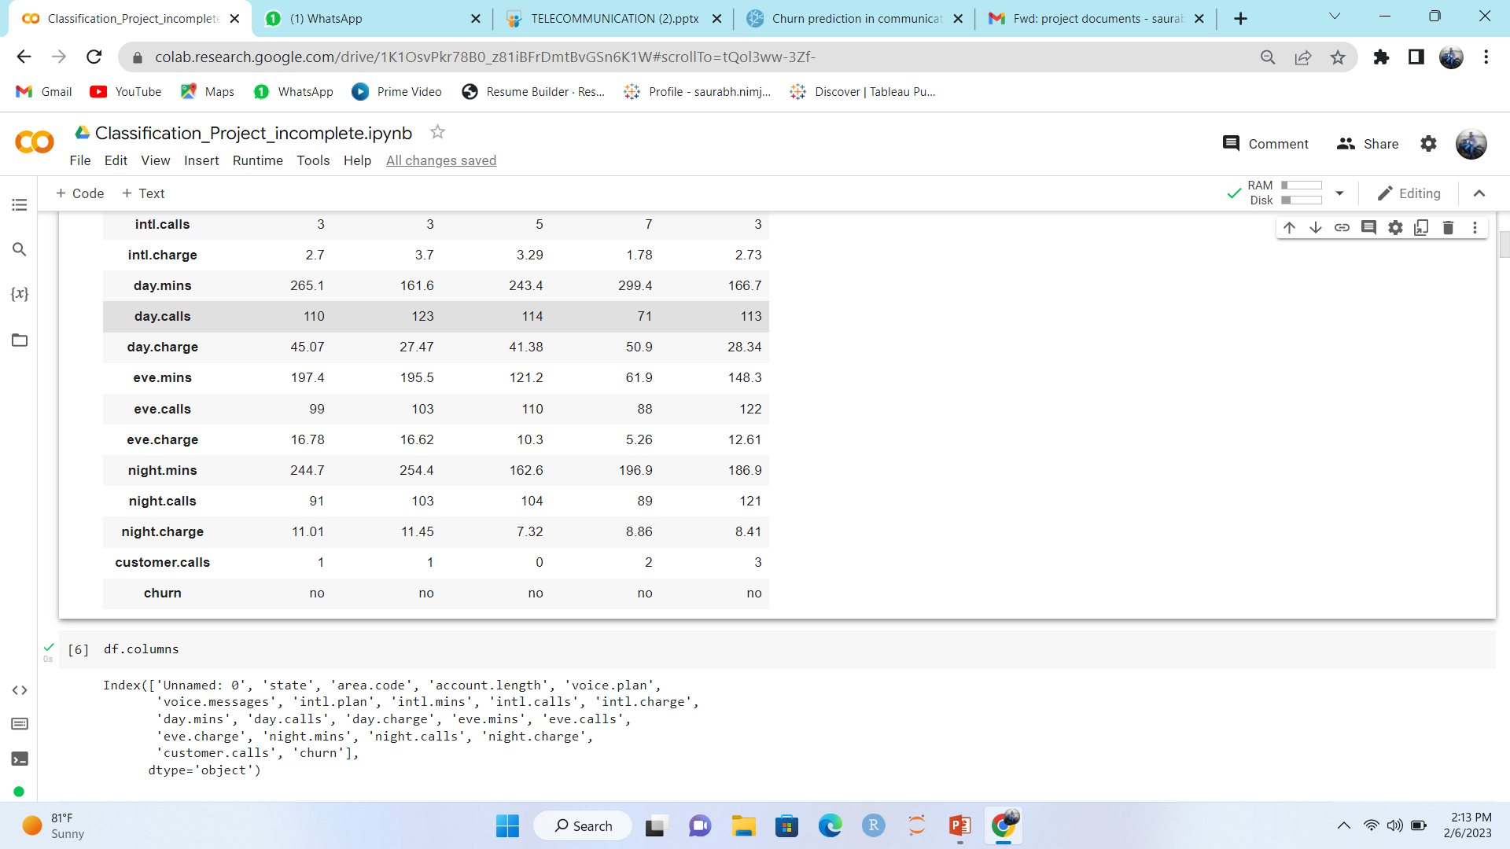
Data Set:-

Slide 6
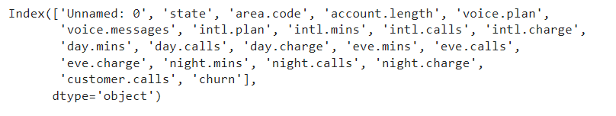
Features:-

Slide 7
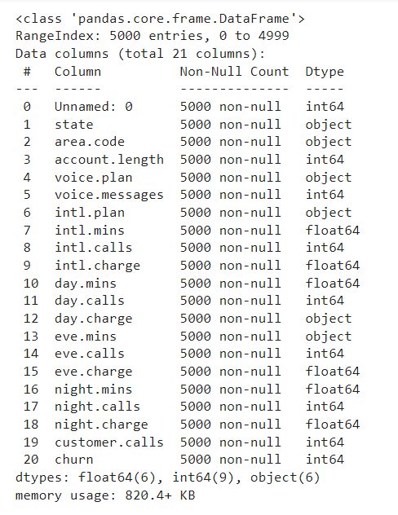
Rows:- 5000
Columns:-21
Dataset contains:
5000 non-null records (or rows)
21 features (or columns)
dtypes: float (6), int (8), object (7)
‘day.charge, eve.min are float but info showed as object, may be due to the presence of few ‘Nan’ values.

Slide 8
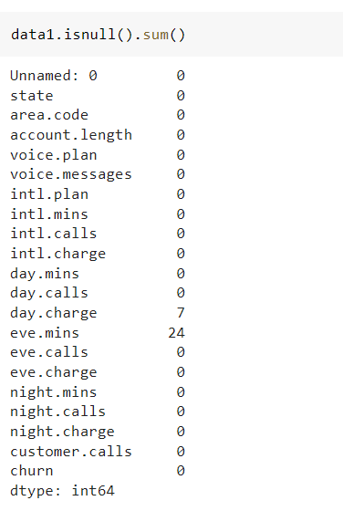
Null Values:-

Slide 9
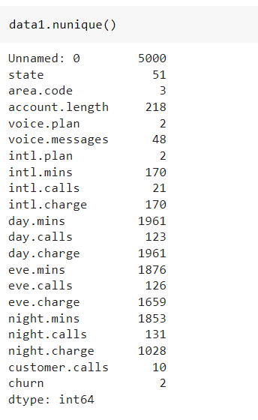
Unique Values:-

Slide 10
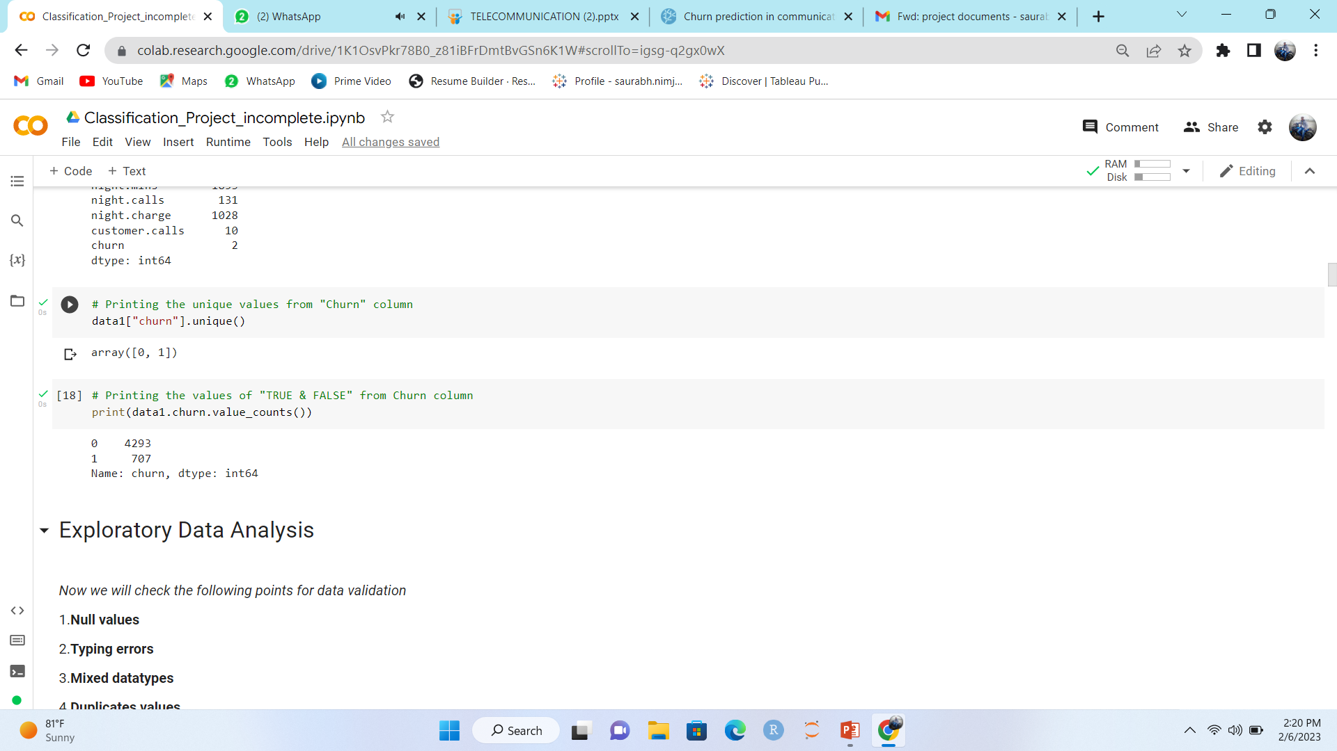
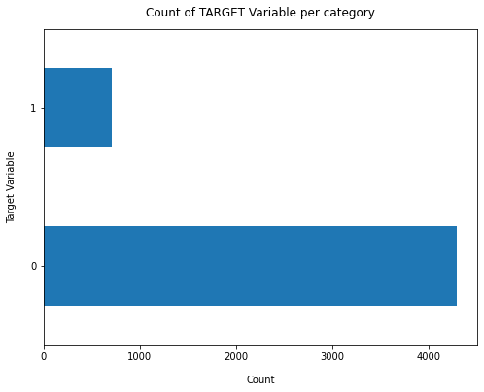
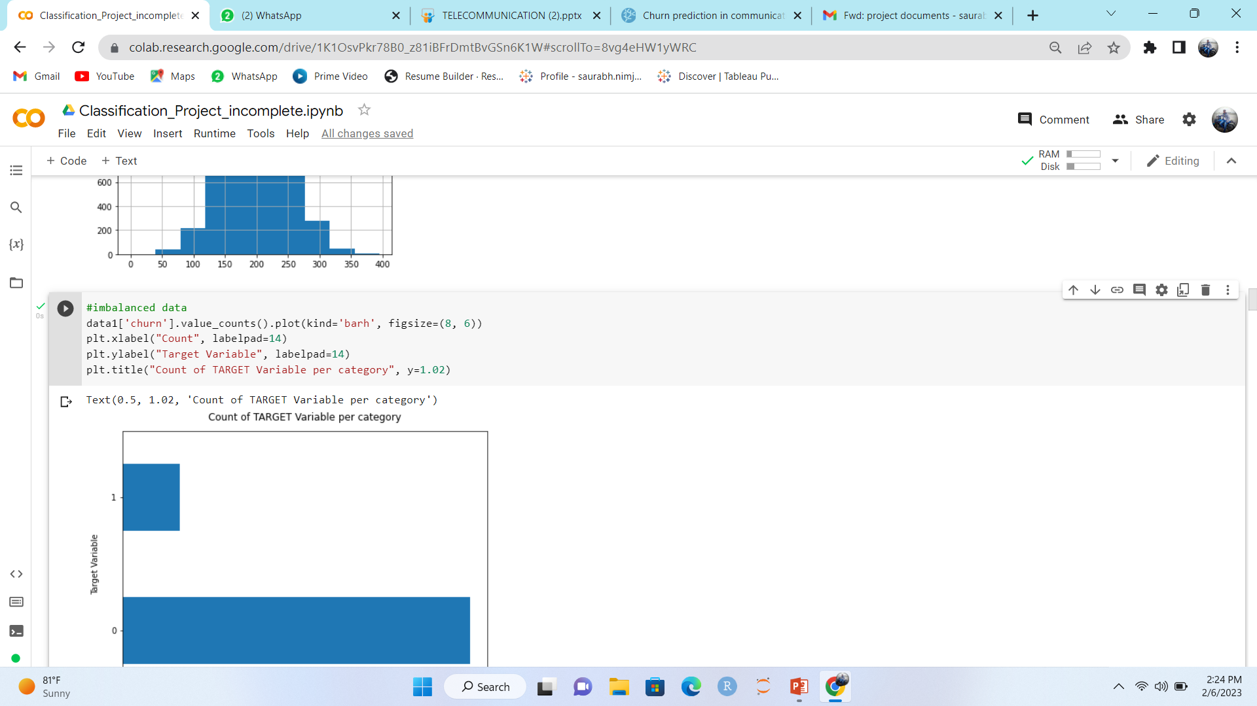
Zero and One:-

Slide 11
EDA:-
Now we will check the following points for data validation
1.Null values 2.Typing errors 3.Mixed data types 4.Duplicates values
Then we can explore and do data visualization like Distribution of
data, outliers detection and replacement, Use Density plot,
Histogram to get more detail regarding concentration, distribution,
outliers, range etc. of data, Check the Correlation between the
variable.

Slide 12
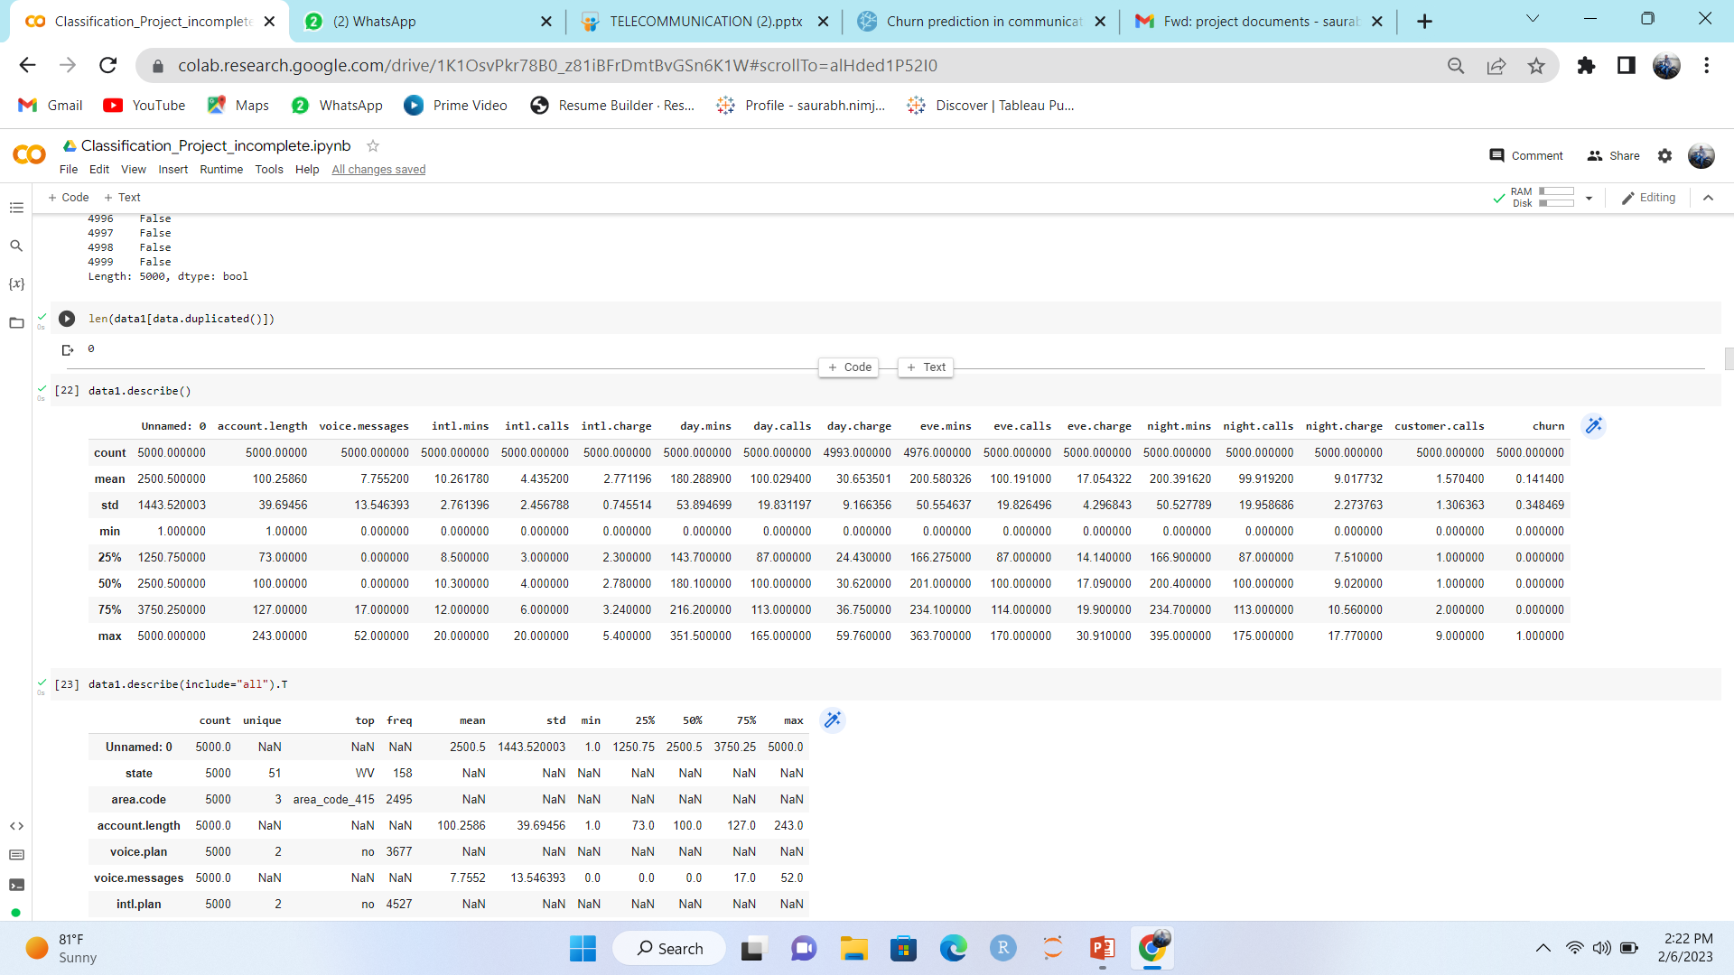
Describe Dataset:-

Slide 13
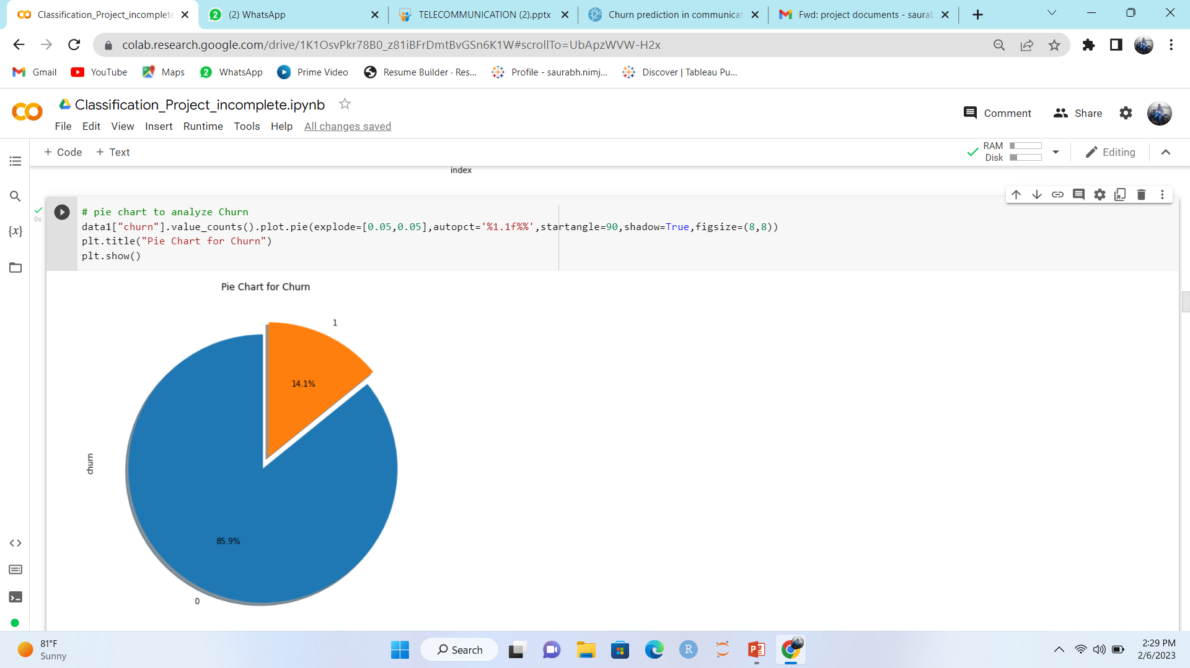
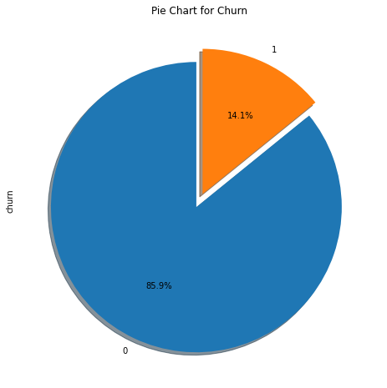
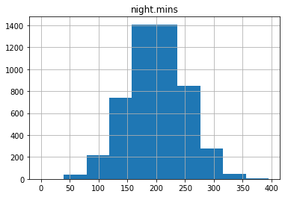
Pie Chart
Histogram

Slide 14
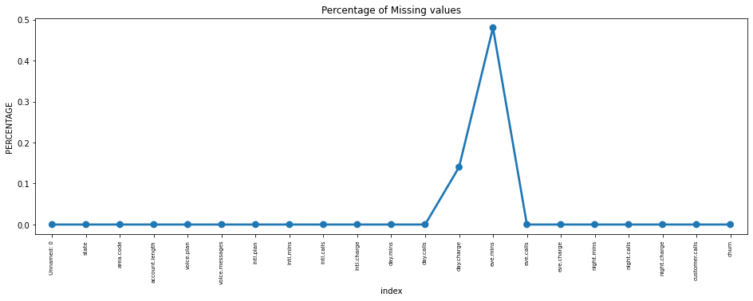
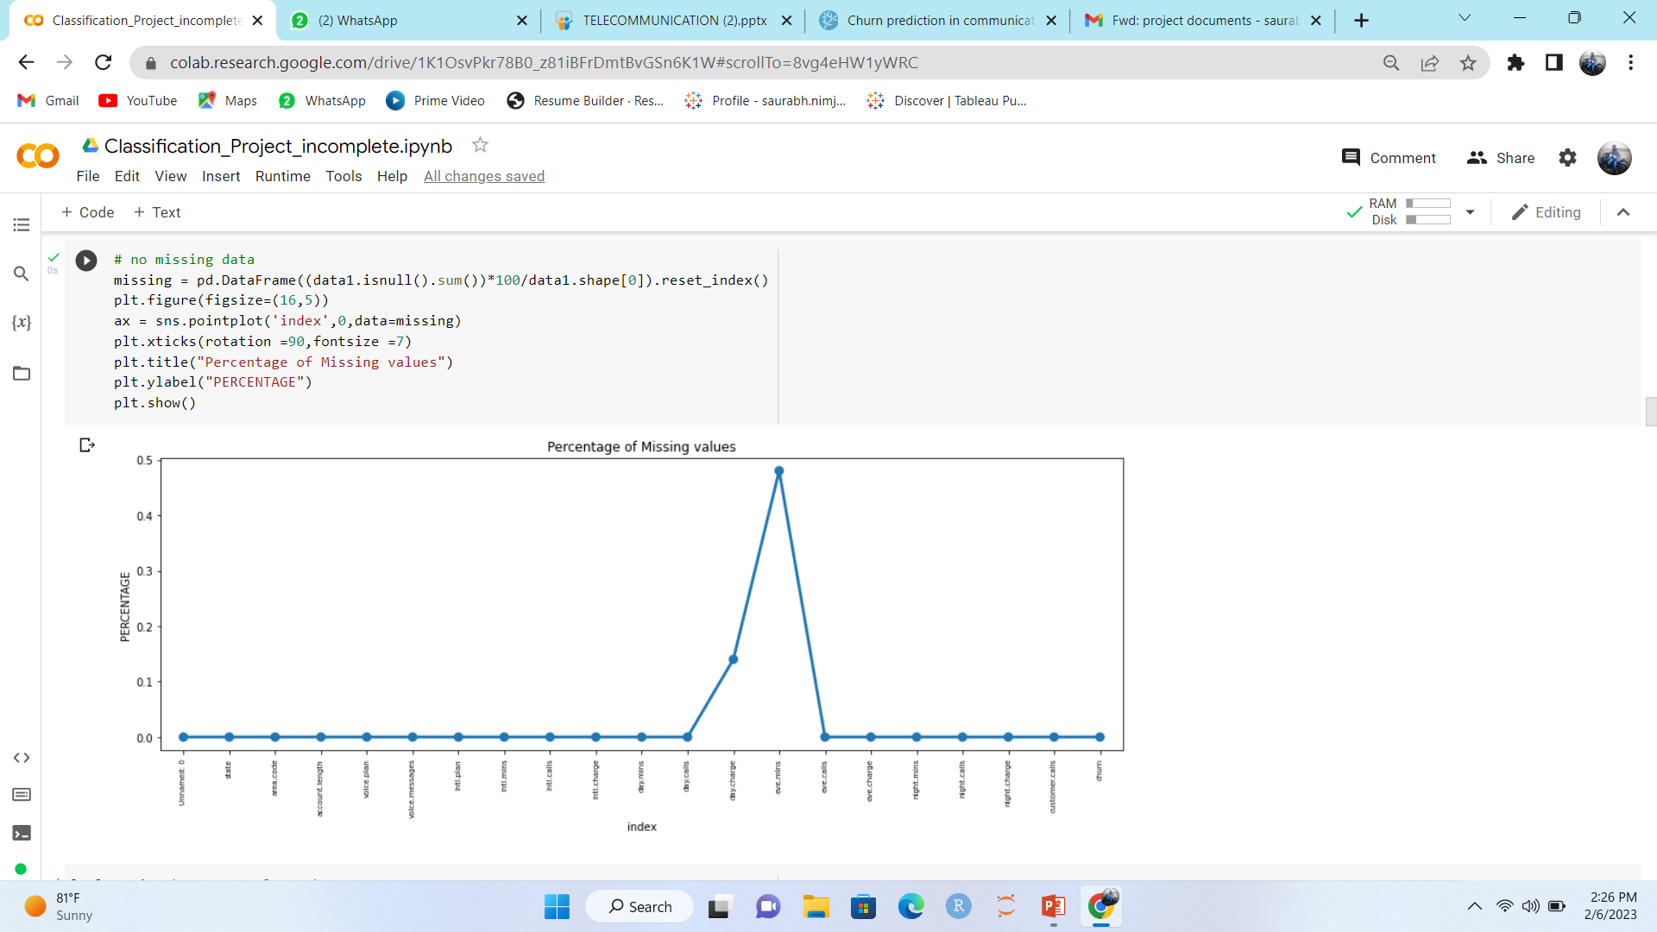
Maximum Missing values Present in eve.mins Column.

Slide 15
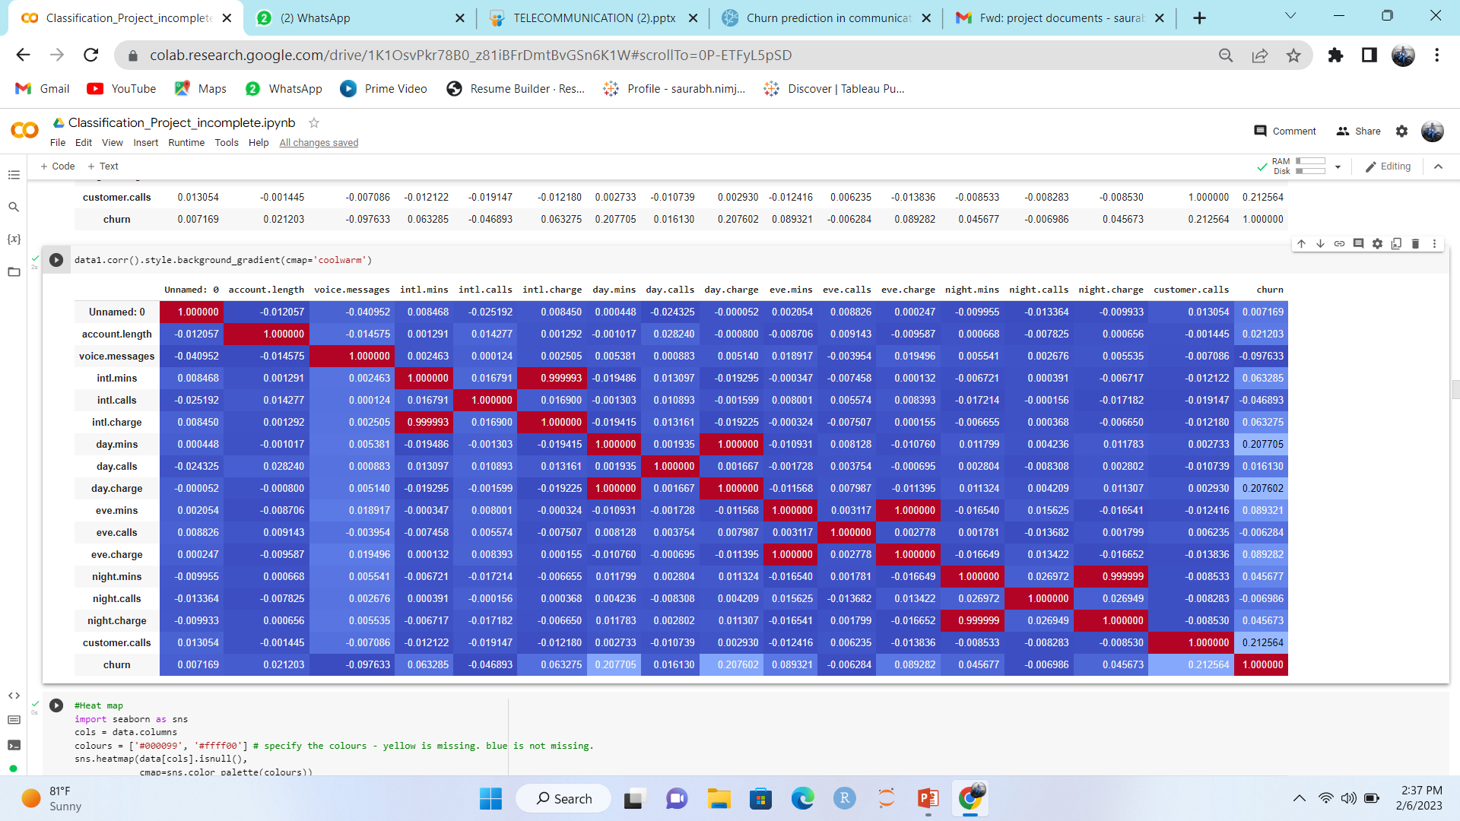
Correlation metrix using
pandas:-

Slide 16
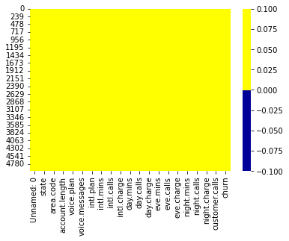
Heat Map:-

Slide 17
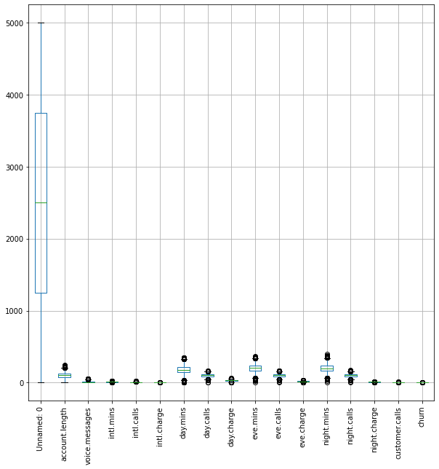
Box Plot:-

Slide 18
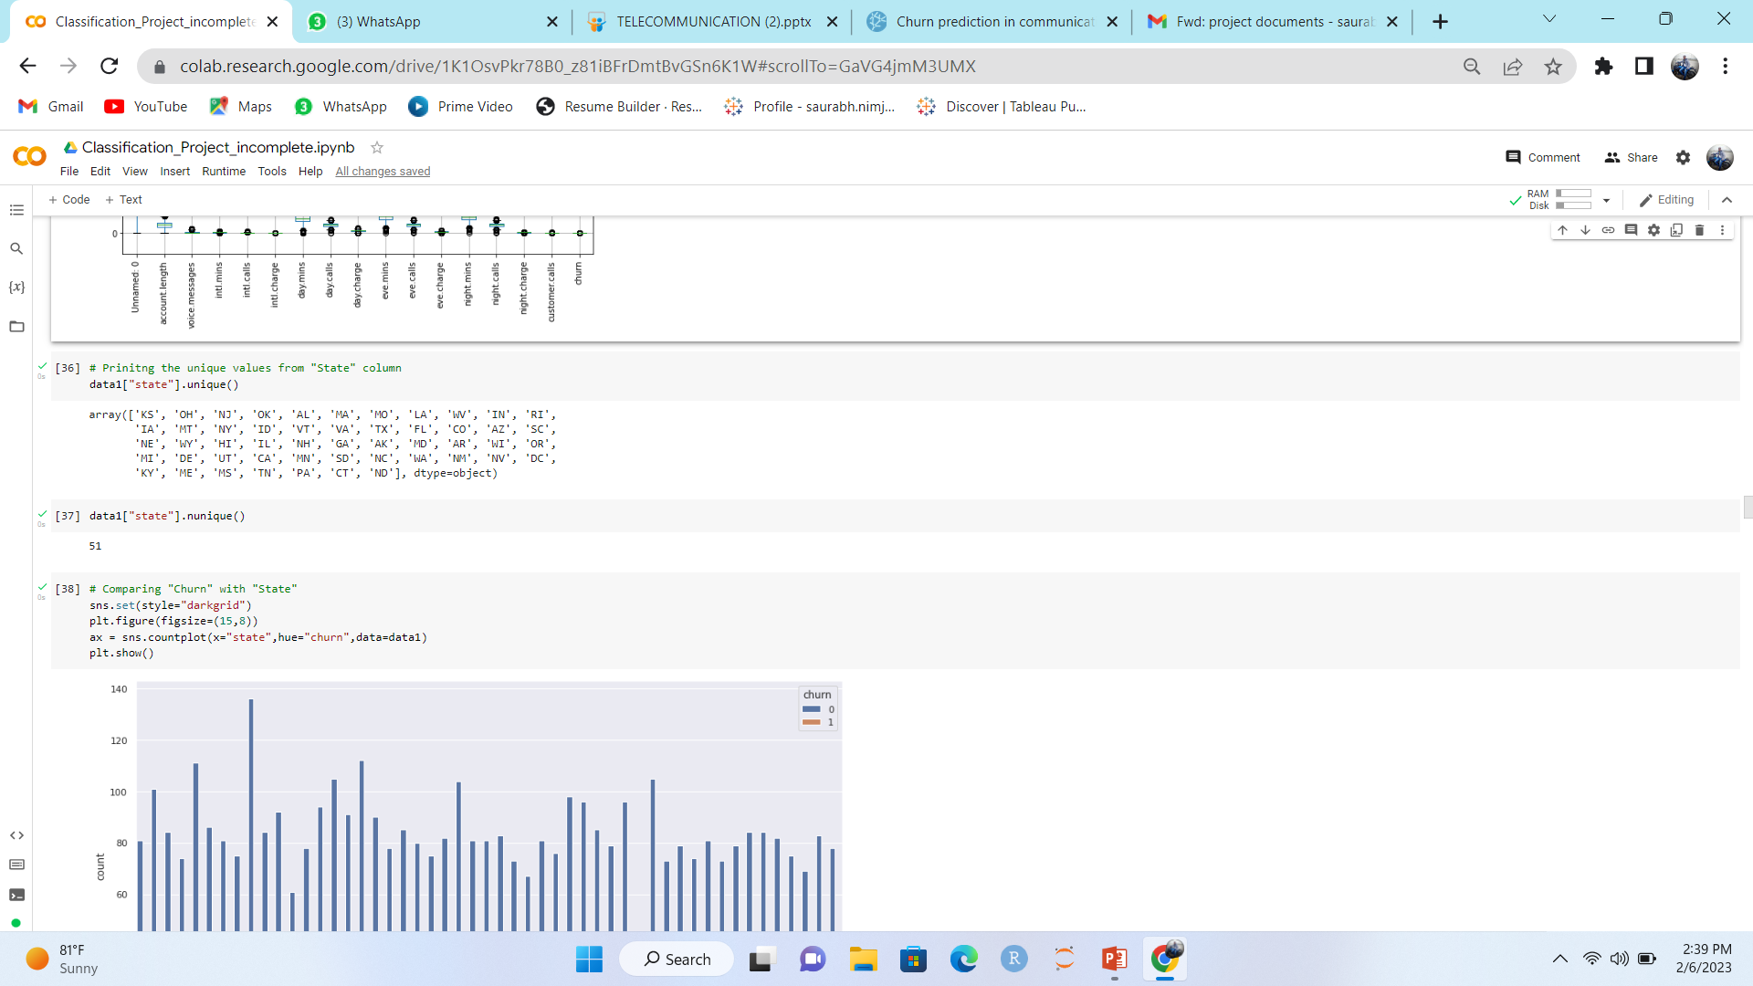
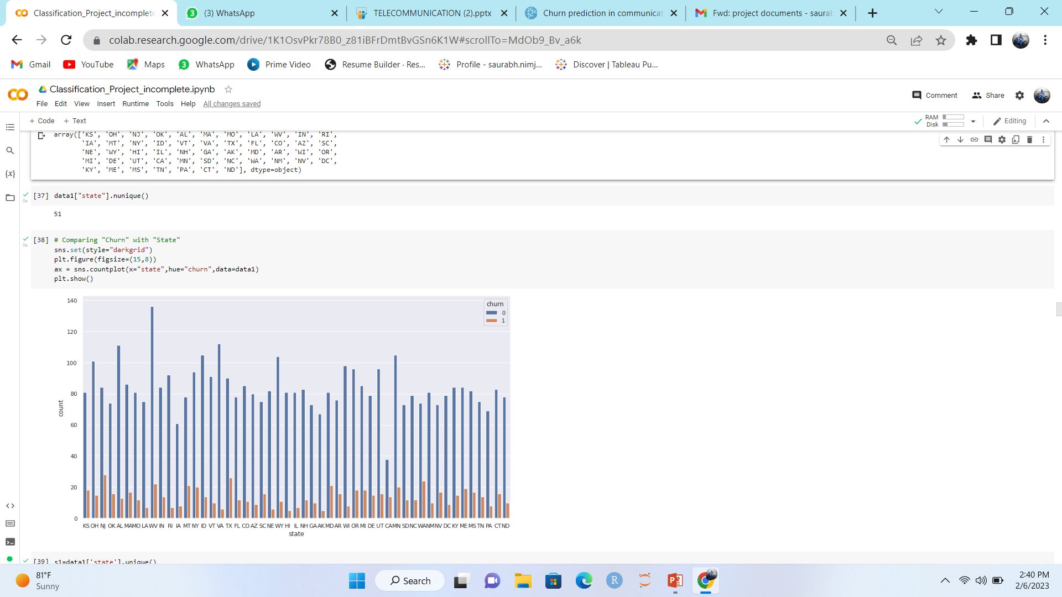
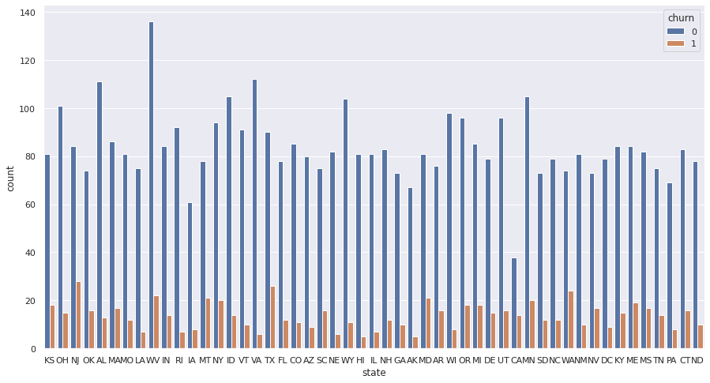
Comparing "Churn" with "State“ :-

Slide 19
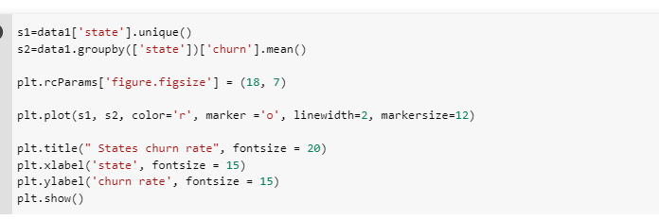
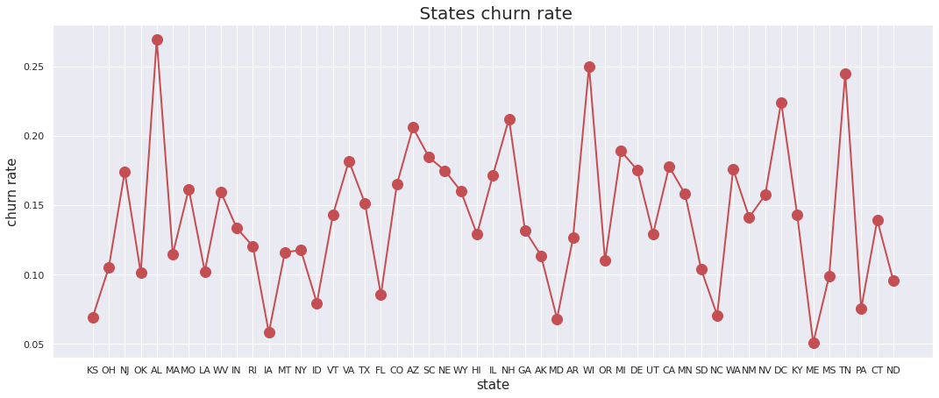
States
churn
rate:-

Slide 20
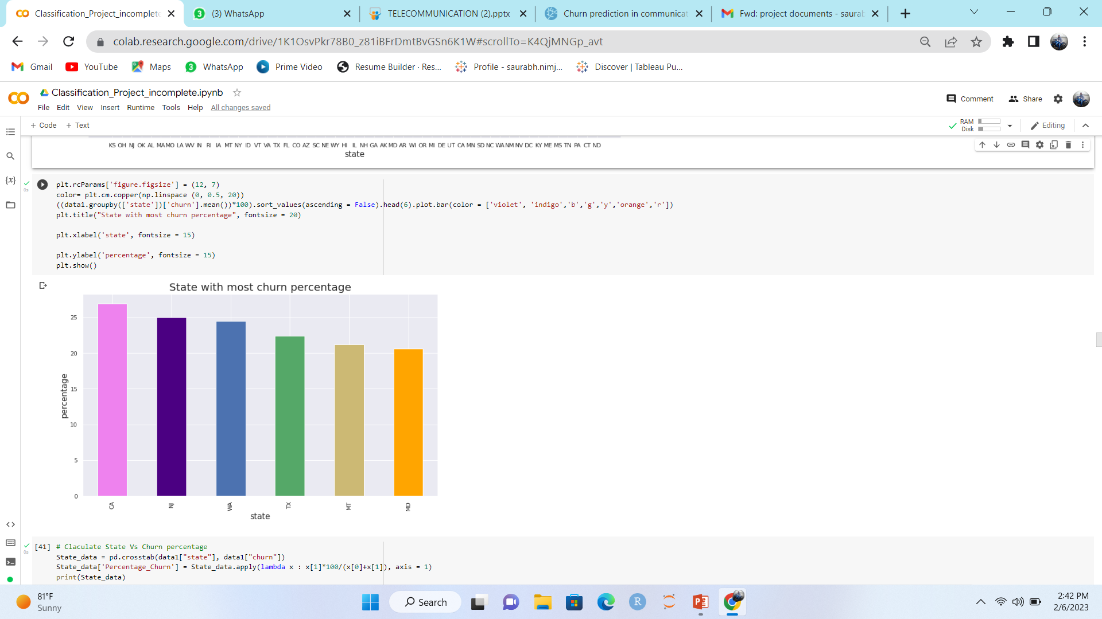
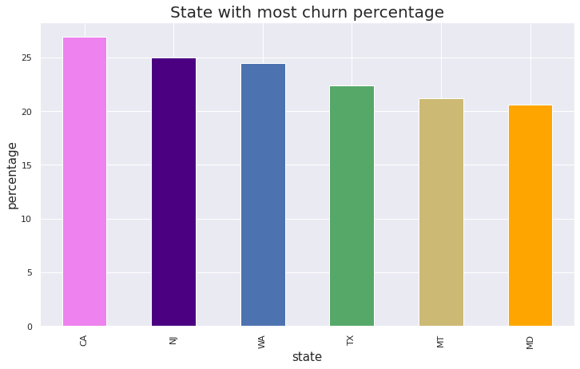
State with most
churn percentage:-

Slide 21
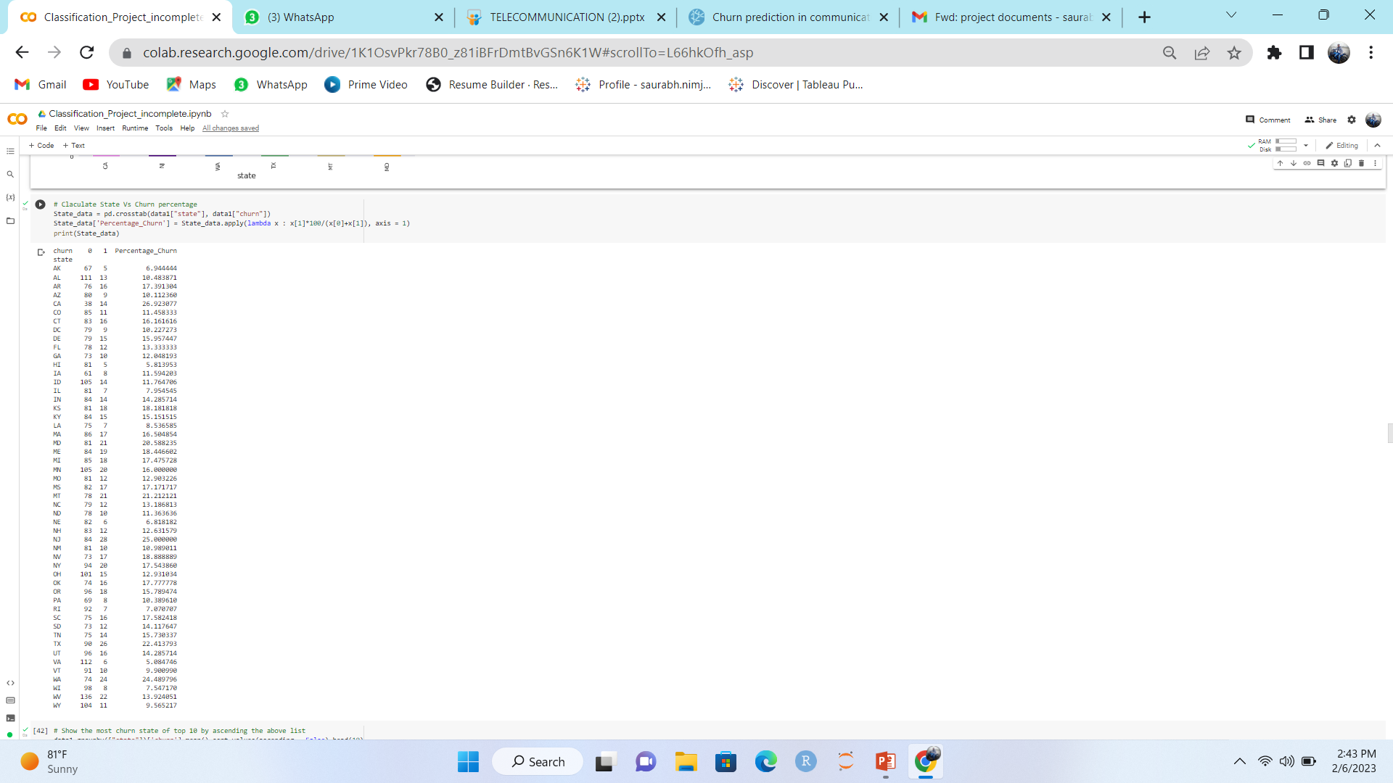
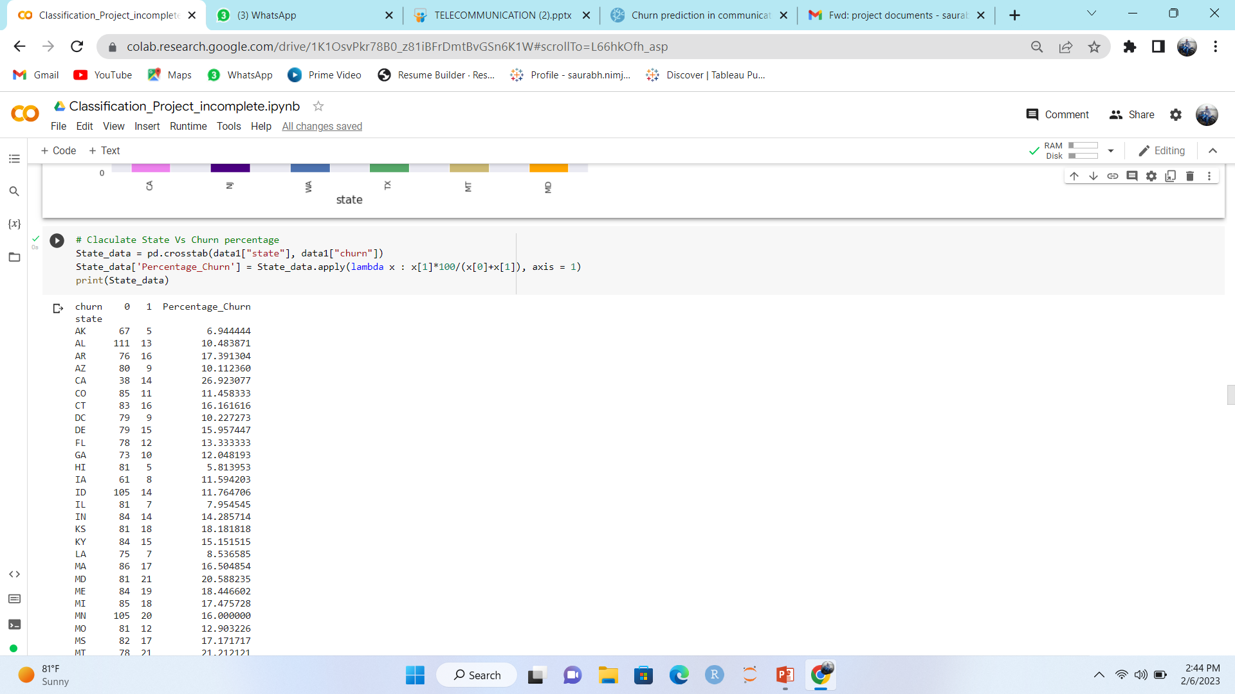
Calculate State
Vs
Churn percentage :-

Slide 22
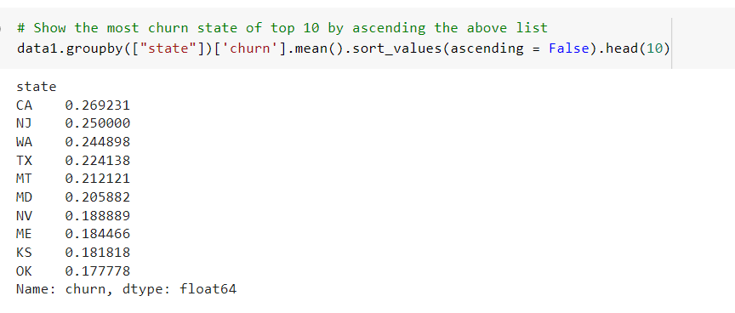
Show the most churn state of top 10 by ascending the above list:-

Slide 23
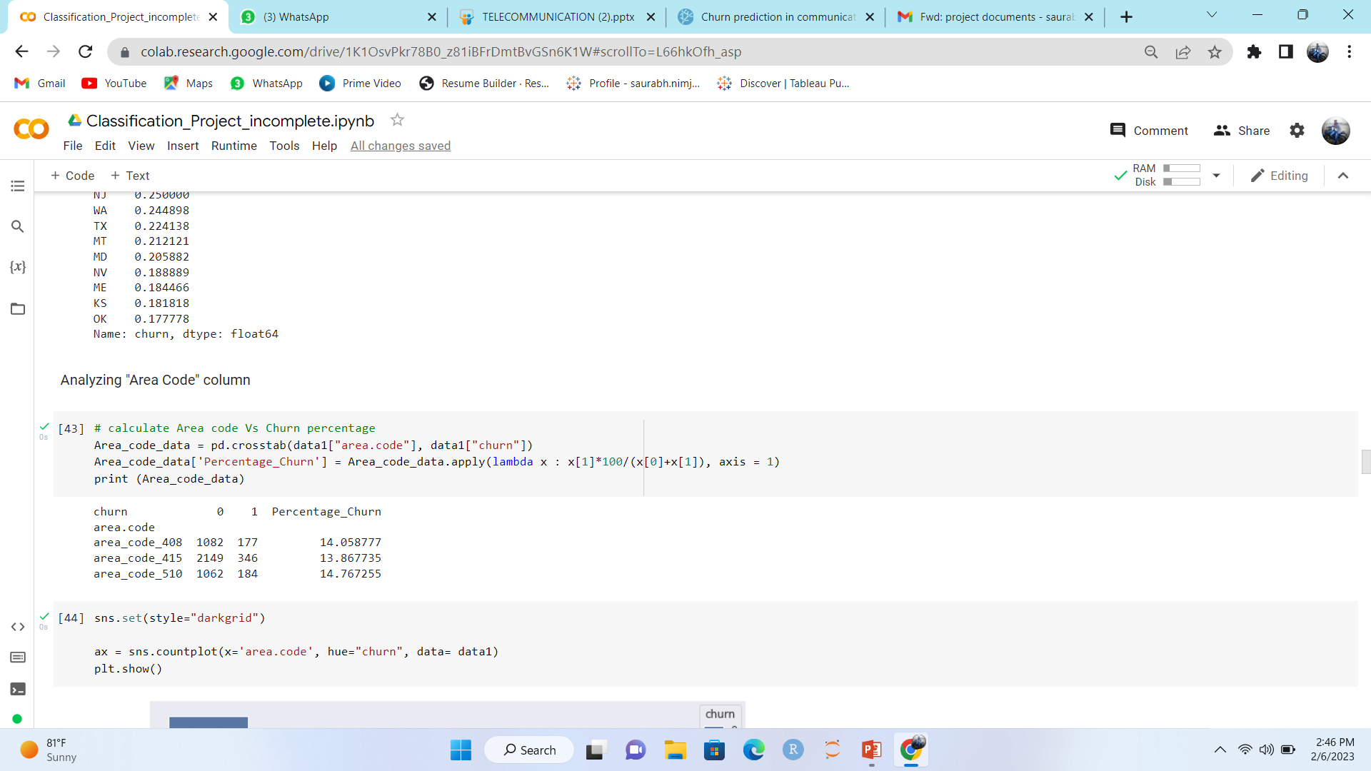
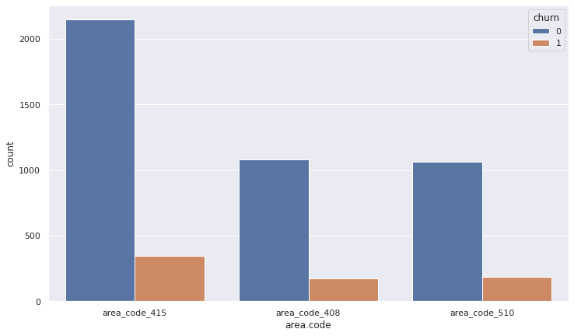
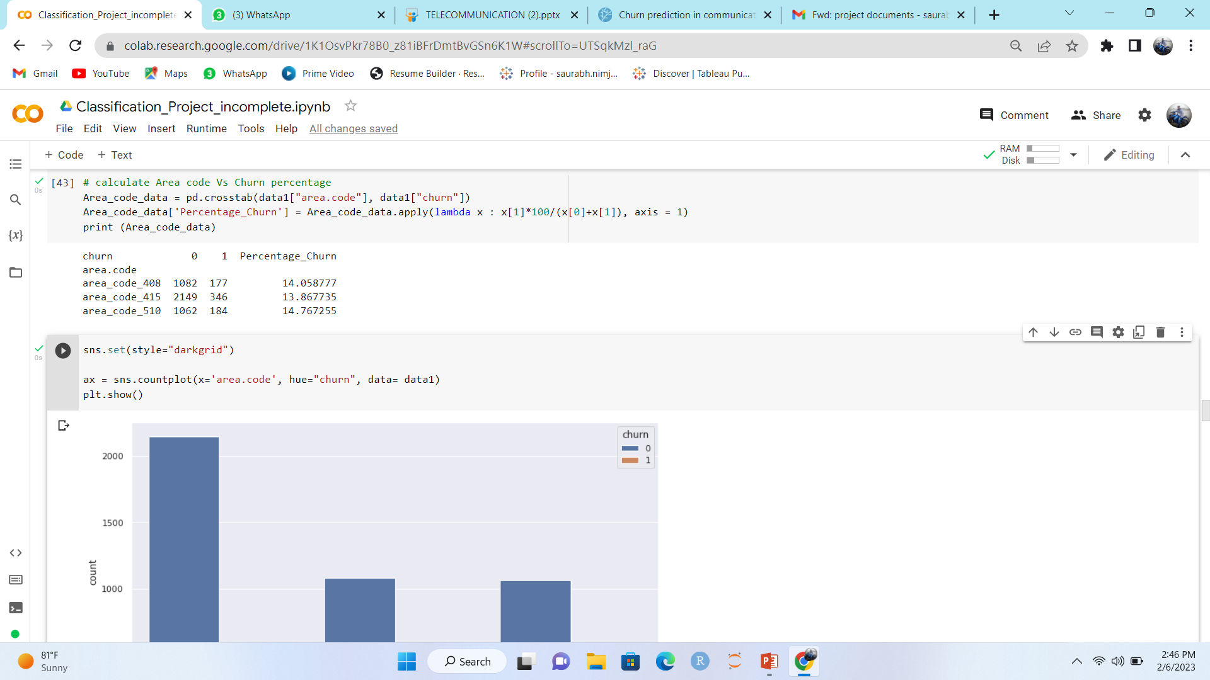
Calculate Area code
Vs
Churn percentage

Slide 24
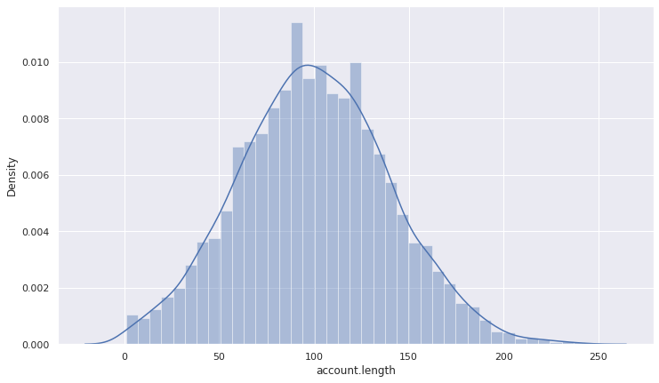
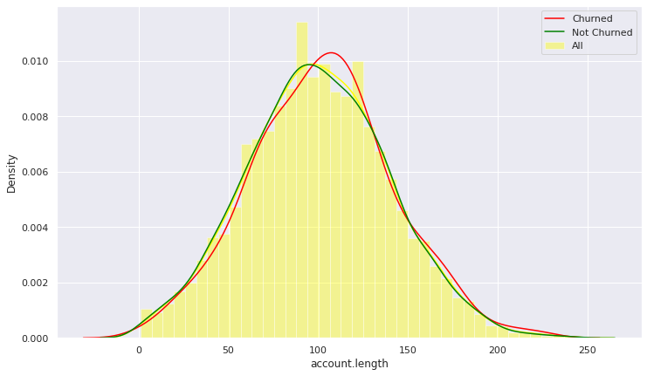
Density Plot:-
Account length
Vs
Churn
Comparison of churned account length and not churned account length

Slide 25
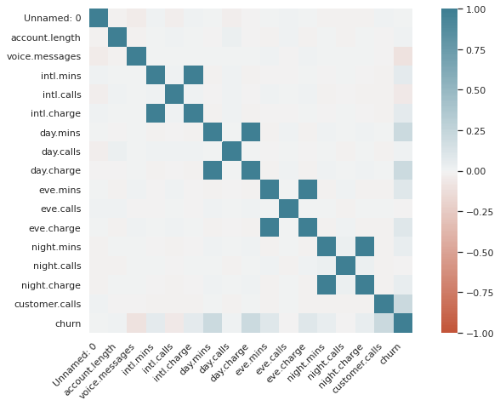
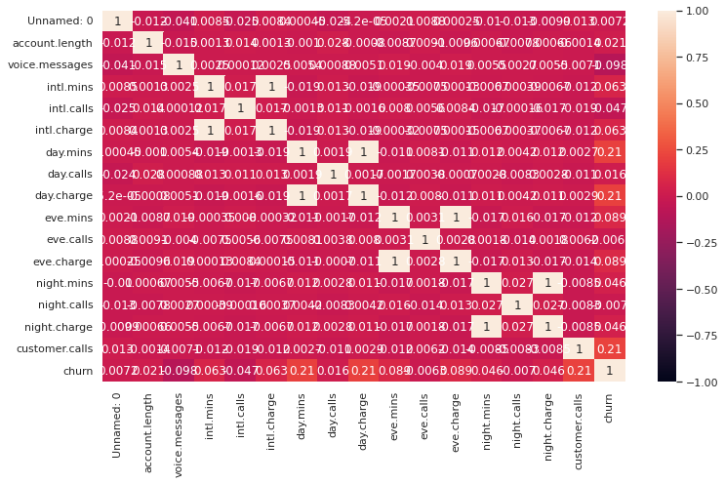
Correlation metrix
using seaborne :-

Slide 26
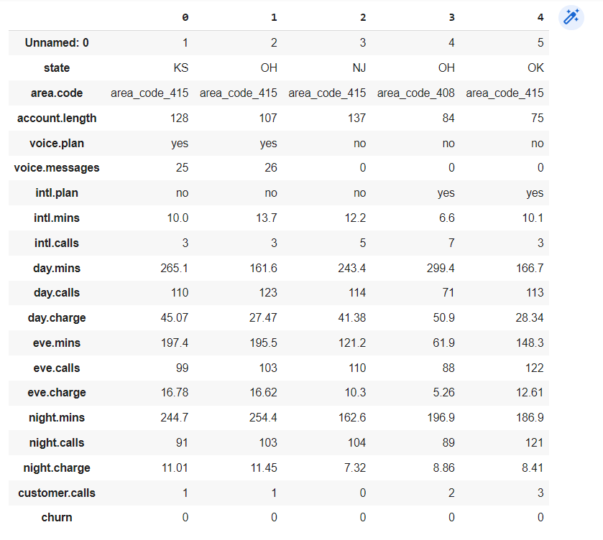
Code:- data2=data1.drop(['intl.charge'], axis=1)
After Drop ‘Intl.charge’
Column the dataset is

Slide 27
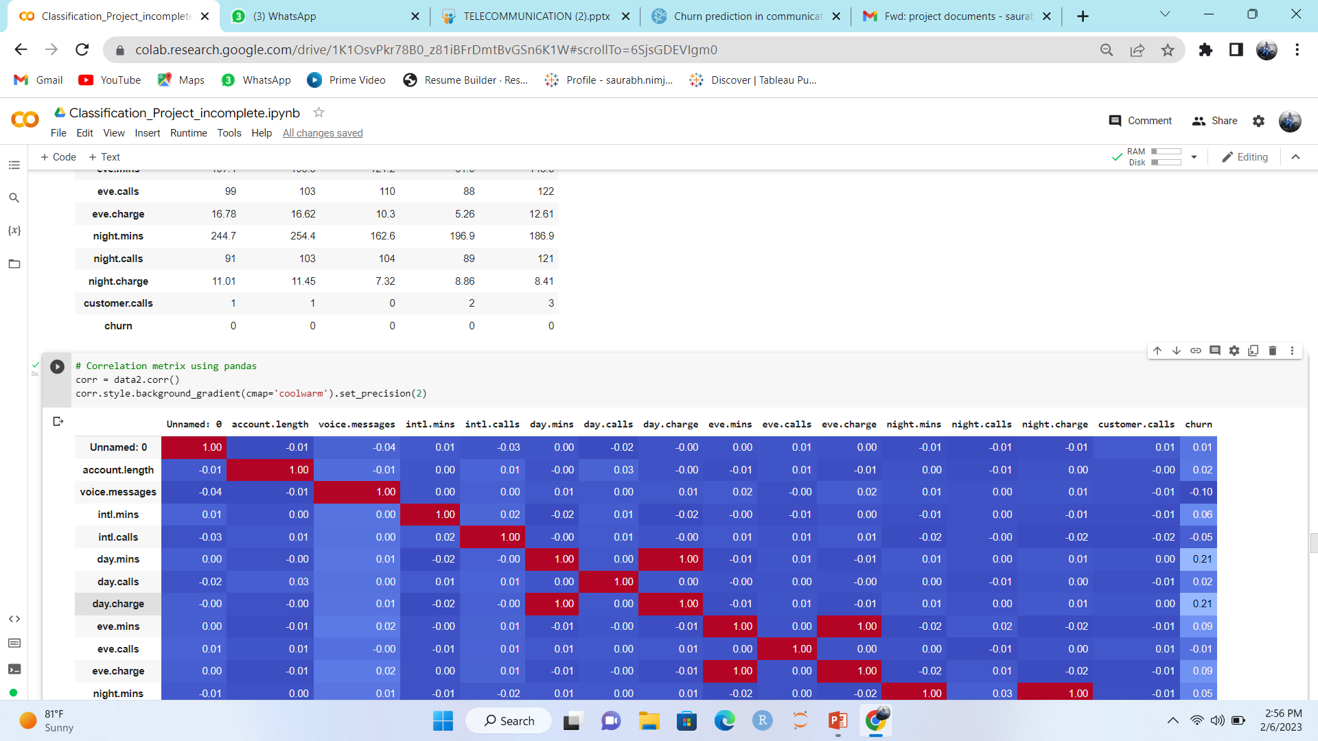
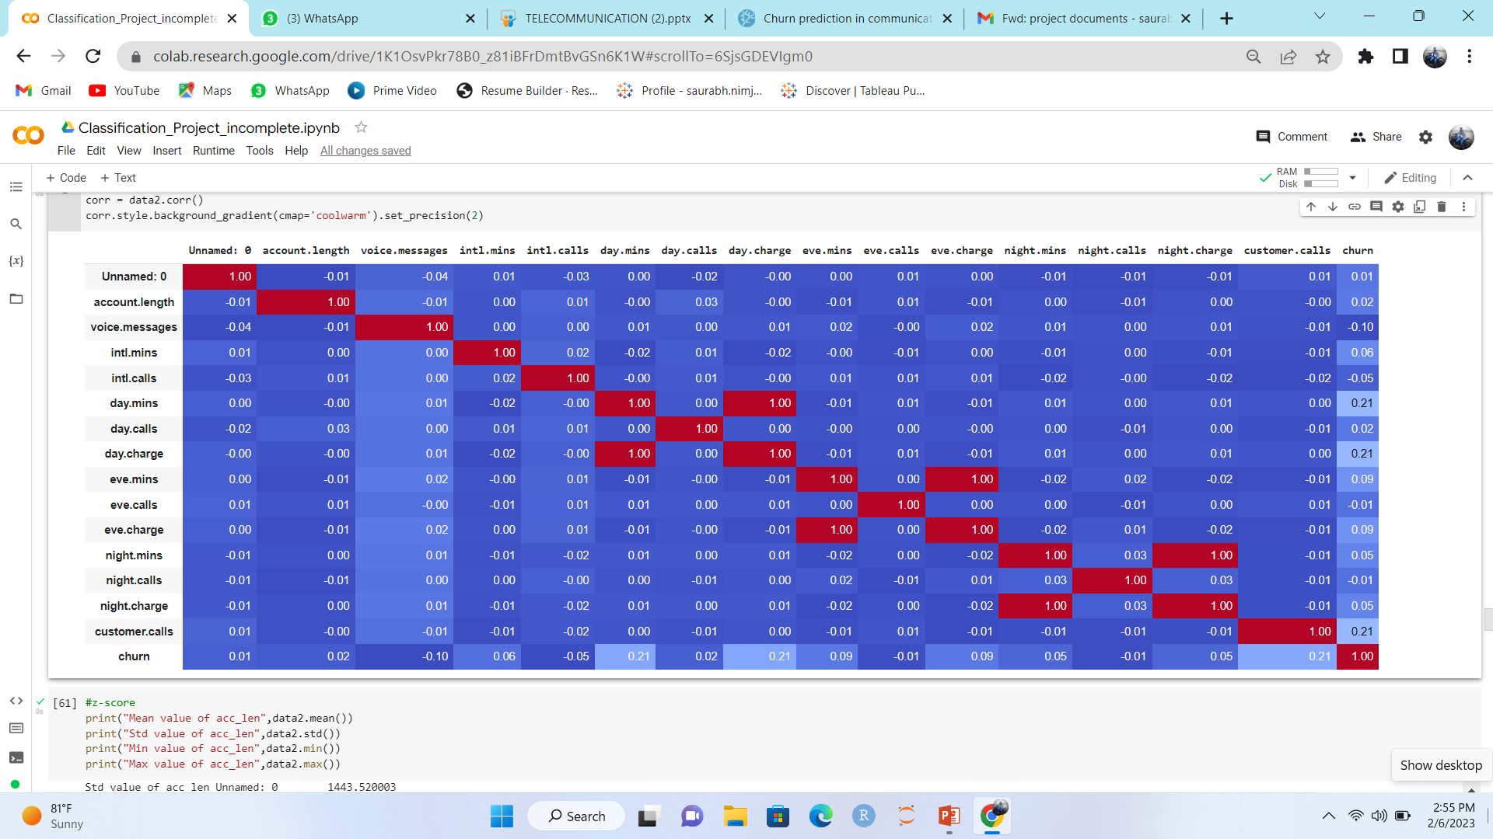
Correlation metrix
using seaborne :-

Slide 28
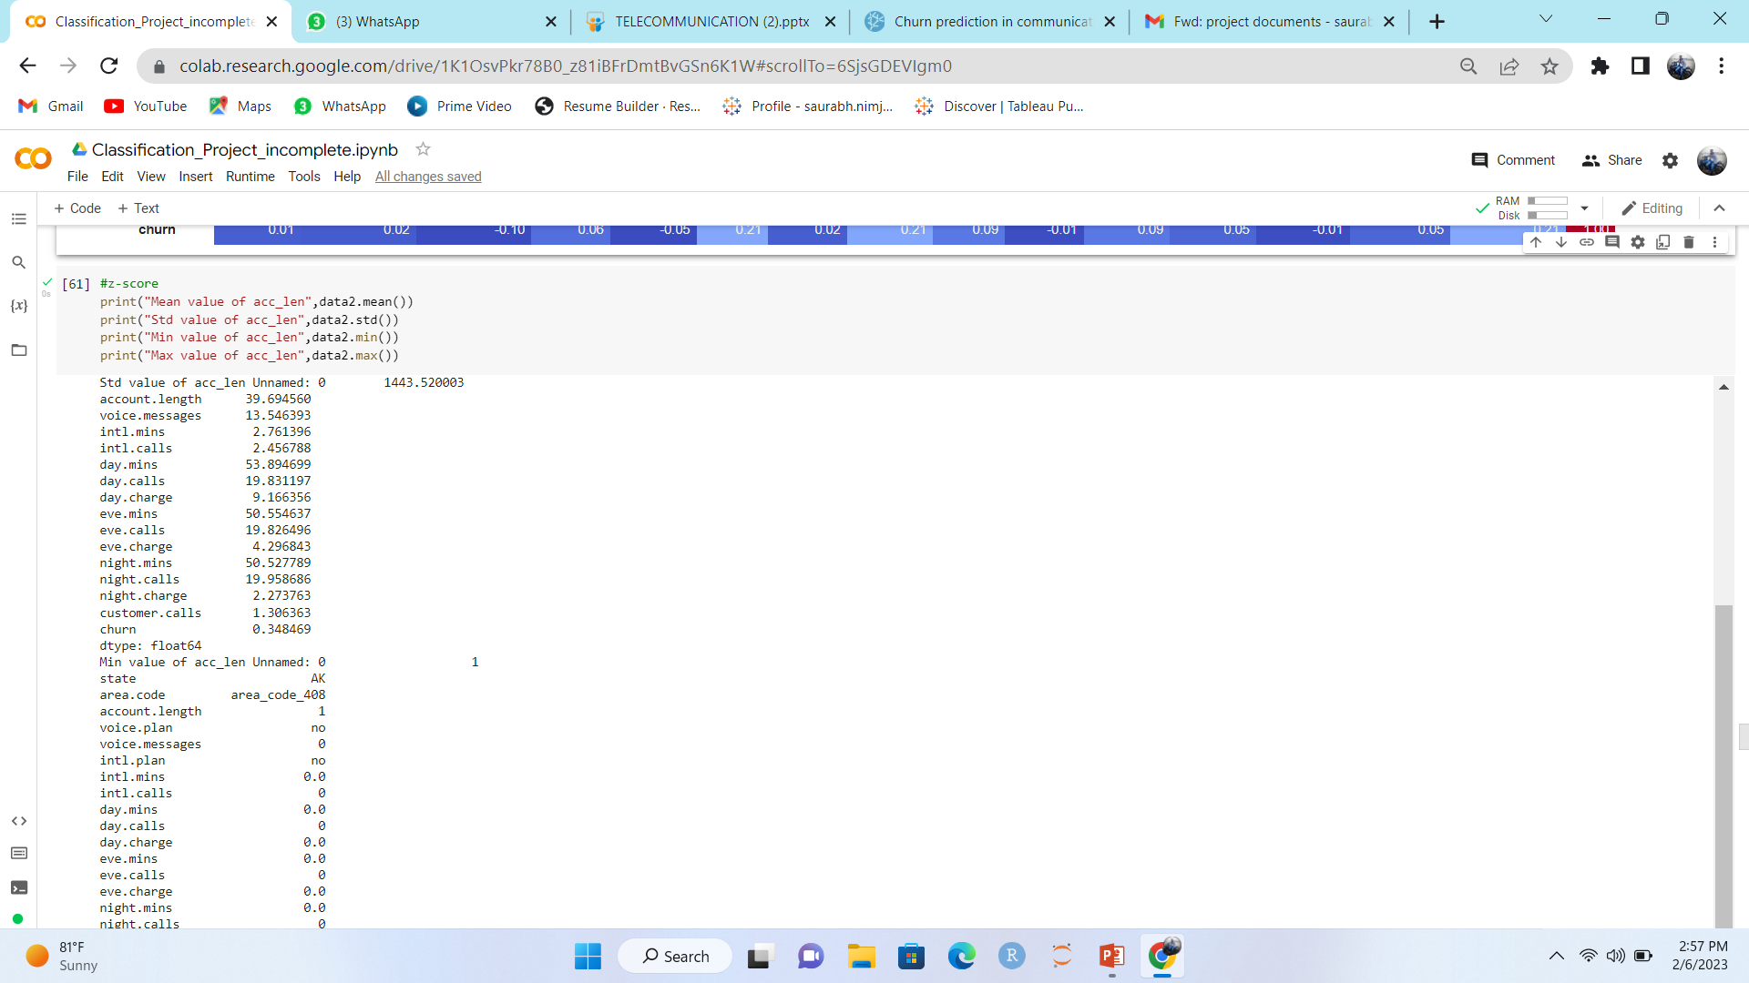
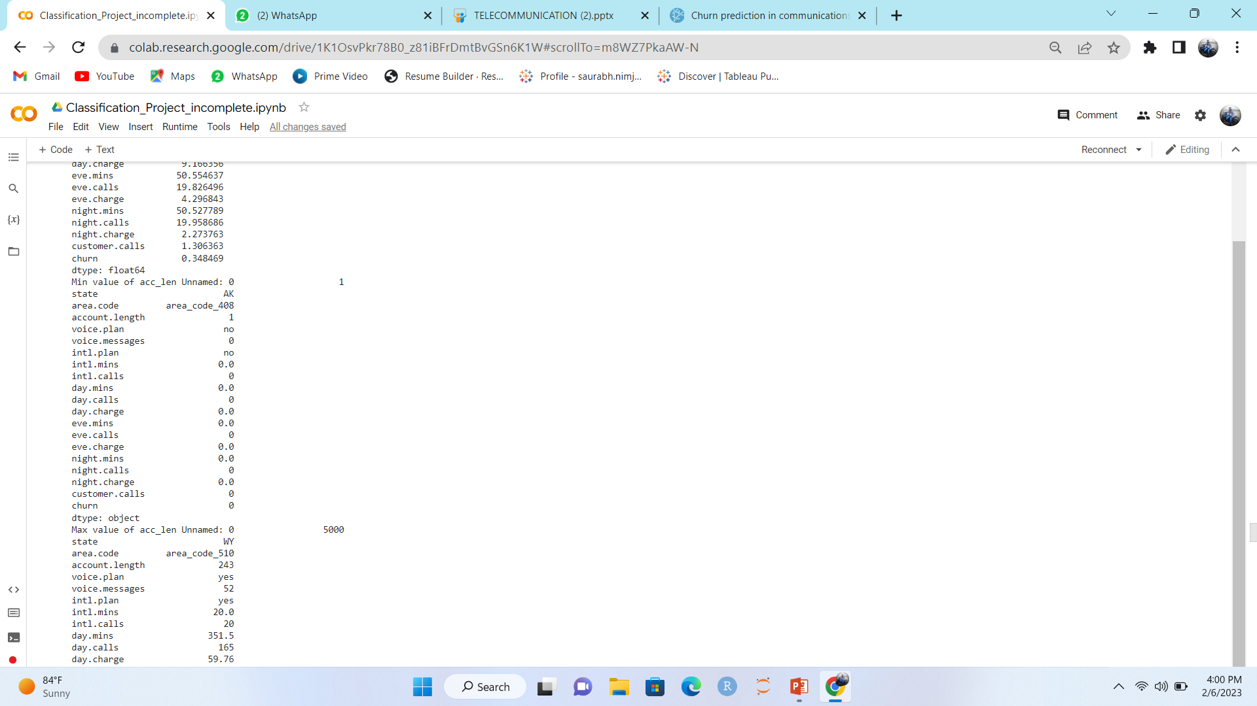
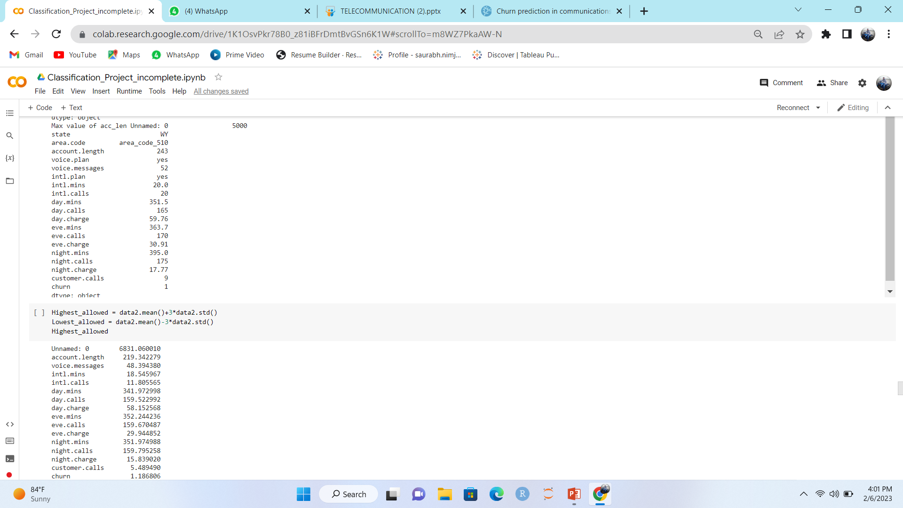
Z-score:-

Slide 29
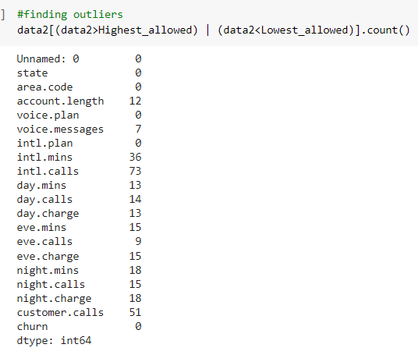
finding outliers:-

Slide 30
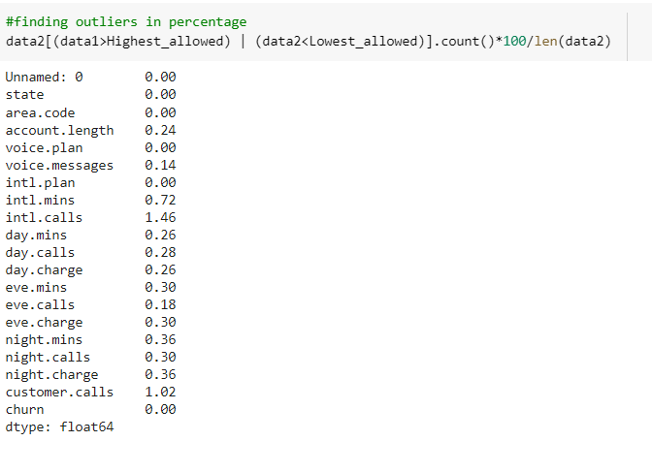
finding outliers in
percentage:-
International calls has highest percentage outlier

Slide 31
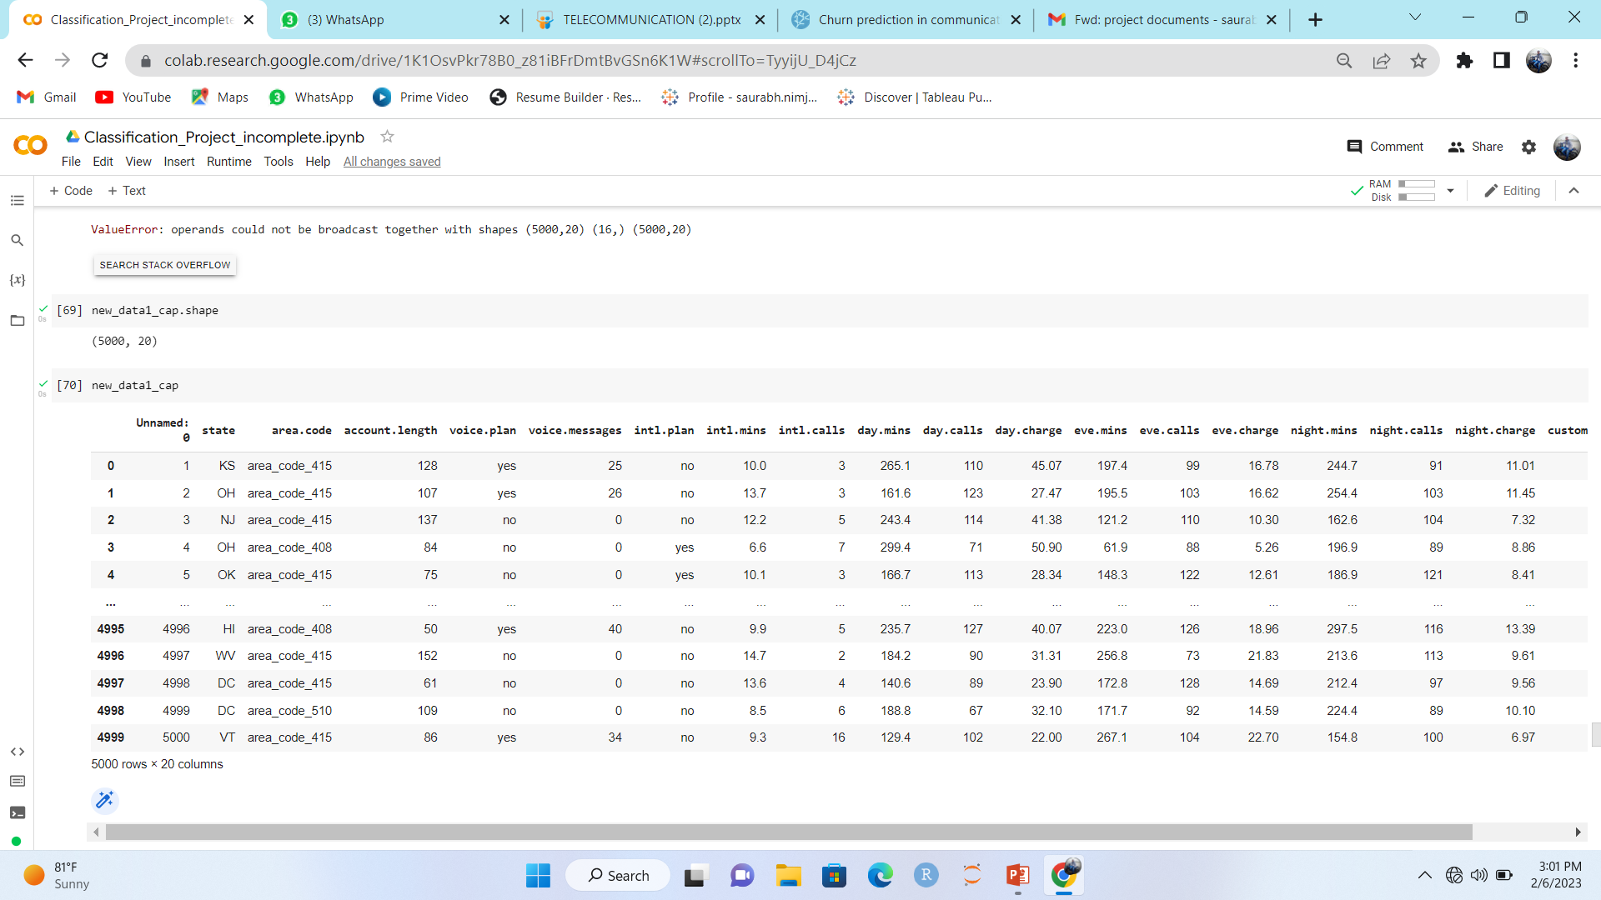
Drive New Dataset :-

Slide 32
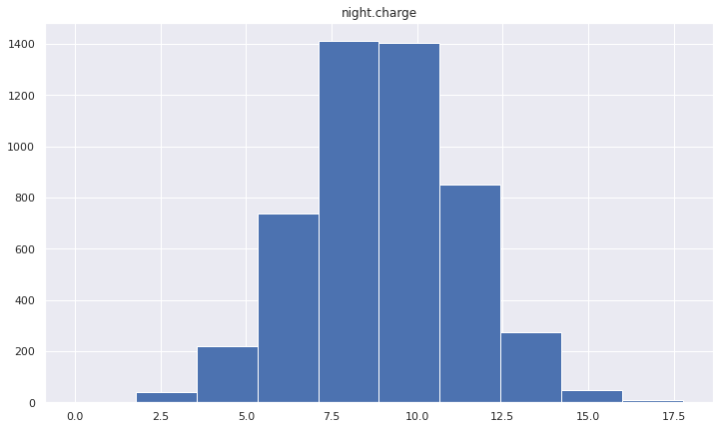
Histogram:-

Slide 33
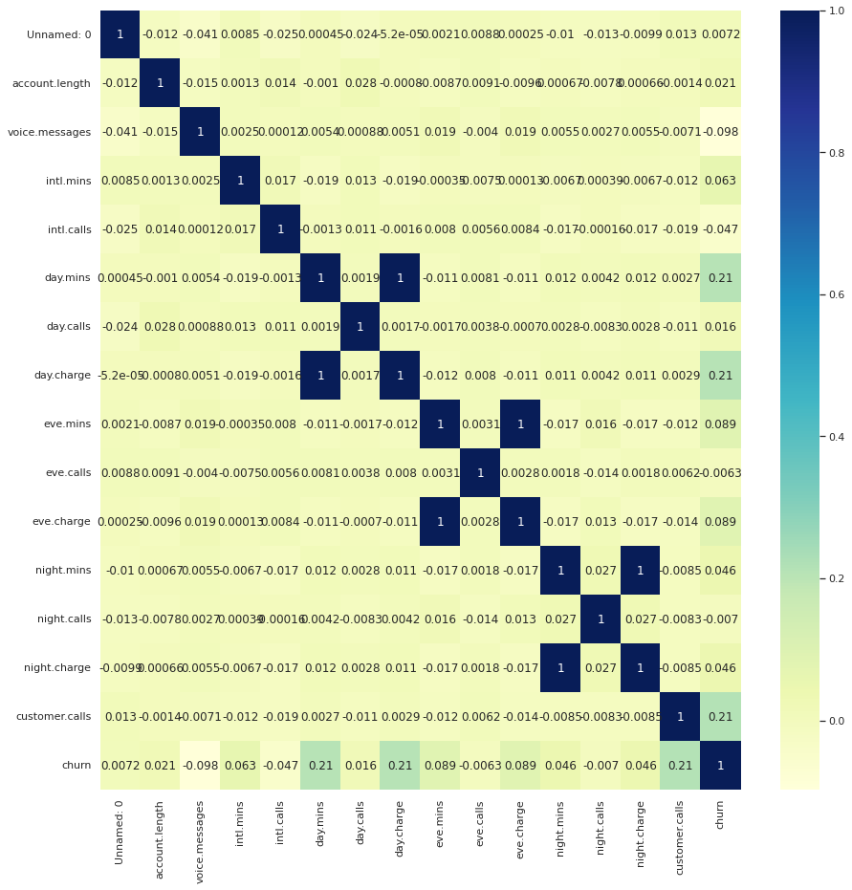
Correlation metrix :-
intl.charge and
intl.min has strong
correlation.
churn and
voice.messages has weak correlation.

Slide 34
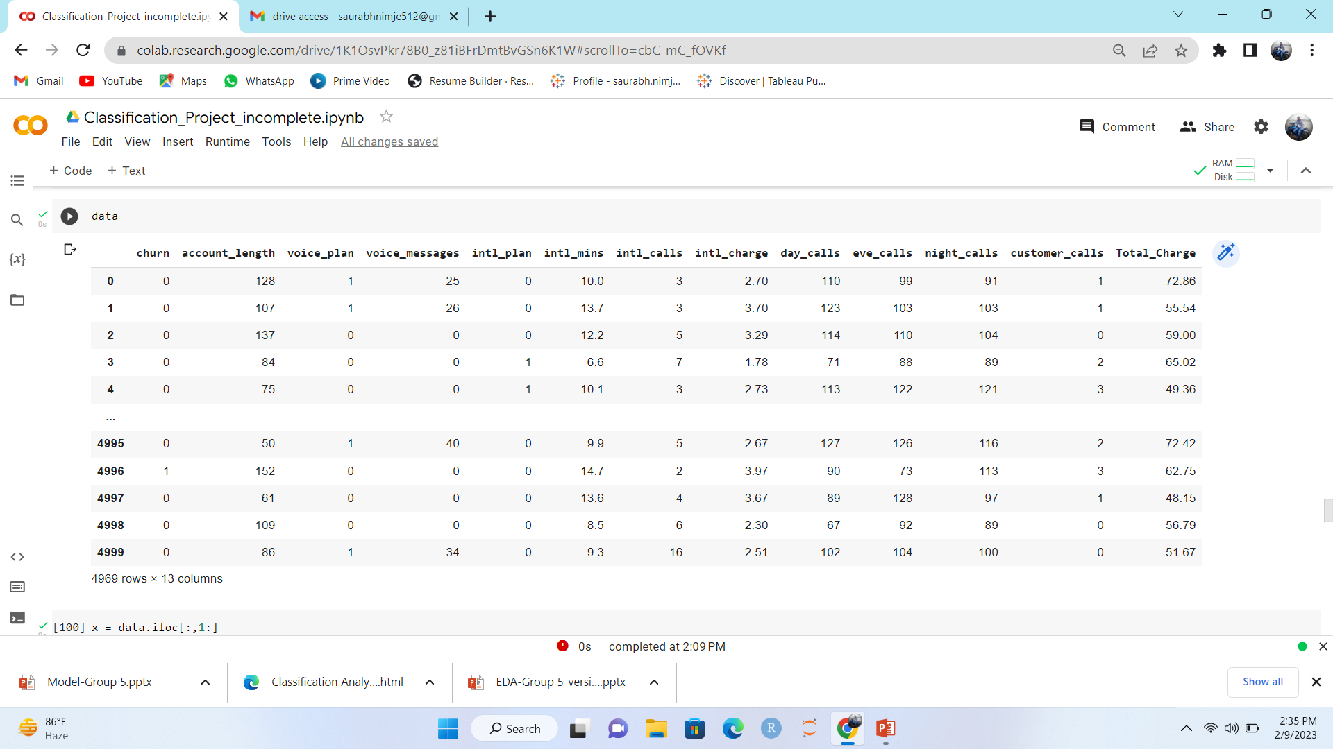
data['Total_Charge'] = data['day_charge'] + data['eve_charge'] + data['night_charge']

Slide 35
Classification
model
building

Slide 36
Logistic Regression :-
precision recall f1-score support
0 0.80 0.78 0.79 1296
1 0.78 0.80 0.79 1263
accuracy 0.79 2559
macro avg 0.79 0.79 0.79 2559
weighted avg 0.79 0.79 0.79 2559
0.7889774601429356
Accuracy= 78%

Slide 37
KNN :-
precision recall f1-score support
0 0.99 0.89 0.94 1296
1 0.89 0.99 0.94 1263
accuracy 0.94 2559
macro avg 0.94 0.94 0.94 2559
weighted avg 0.94 0.94 0.94 2559
0.9377635593136081
Accuracy= 93%

Slide 38
Decision Tree:-
precision recall f1-score support
0 0.94 0.96 0.95 1296
1 0.95 0.94 0.95 1263
accuracy 0.95 2559
macro avg 0.95 0.95 0.95 2559
weighted avg 0.95 0.95 0.95 2559
0.957369321034
Accuracy= 95%

Slide 39
Random Forest :-
precision recall f1-score support
0 0.94 1.00 0.96 1093
1 0.99 0.93 0.96 1039
accuracy 0.96 2132
macro avg 0.97 0.96 0.96 2132
weighted avg 0.96 0.96 0.96 2132
0.9623491848209997
Accuracy= 96%

Slide 40
SVM:-
precision recall f1-score support
0 0.96 0.96 0.96 1093
1 0.95 0.95 0.95 1039
accuracy 0.95 2132
macro avg 0.95 0.95 0.95 2132
weighted avg 0.95 0.95 0.95 2132
0.9549429522193467
Accuracy= 95%

Slide 41
Naive Bayes:-
precision recall f1-score support
0-Less than 50K 0.83 0.77 0.80 1093
1-Above 50K 0.77 0.83 0.80 1039
accuracy 0.80 2132
macro avg 0.80 0.80 0.80 2132
weighted avg 0.80 0.80 0.80 2132
0.8001578965434387
Accuracy= 80%

Slide 42
Bagging
precision recall f1-score support
0 0.95 0.99 0.97 1281
1 0.99 0.94 0.97 1278
accuracy 0.97 2559
macro avg 0.97 0.97 0.97 2559
weighted avg 0.97 0.97 0.97 2559
0.9659836443168331
Accuracy= 96%

Slide 43
AdaBoost Classifier
precision recall f1-score support
0 0.95 0.99 0.97 1281
1 0.99 0.94 0.97 1278
accuracy 0.97 2559
macro avg 0.97 0.97 0.97 2559
weighted avg 0.97 0.97 0.97 2559
0.9679355453087409
Accuracy= 96%

Slide 44
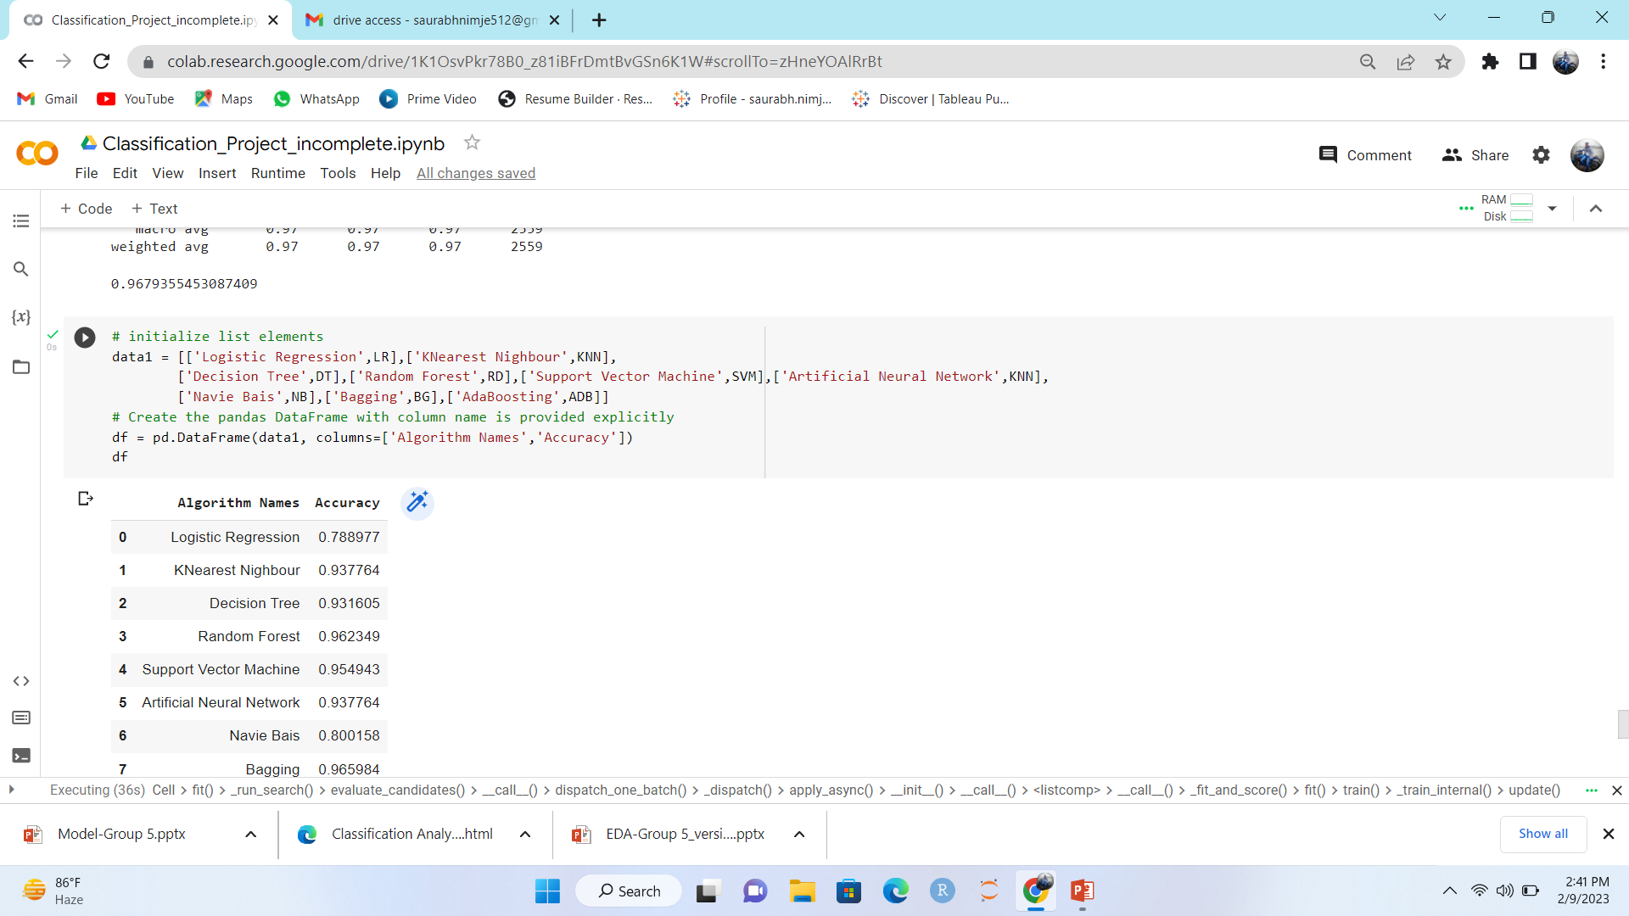
Algorithm Names Accuracy
0 Logistic Regression 0.788977
1 KNearest Nighbour 0.937764
2 Decision Tree 0.931605
3 Random Forest 0.962349
4 Support Vector Machine 0.954943
5 Artificial Neural Network 0.937764
6 Naive Bayes 0.800158
7 Bagging 0.965984
8 AdaBoost 0.967936

Slide 45
Sr. No. | Model | Accuracy Score %
1 | Logistic Regression | 78.8
2 | KNN | 93.7
3 | Decision Tree | 93.1
4 | Random Forest | 96.2
5 | Support Vector Machine | 95.4
6 | Artificial Neural Network | 93.7
7 | Naive Bayes | 80
8 | Bagging | 96.5
9 | AdaBoost | 96.7

Slide 46
Model building: Summary
AdaBoost is found to be the best of all the models.

Slide 47
Deployment
This is the Application we have built for the project and we are running it using Streamlit.
When entered the value it predict that the customer is going to churn or not churn.

Slide 48
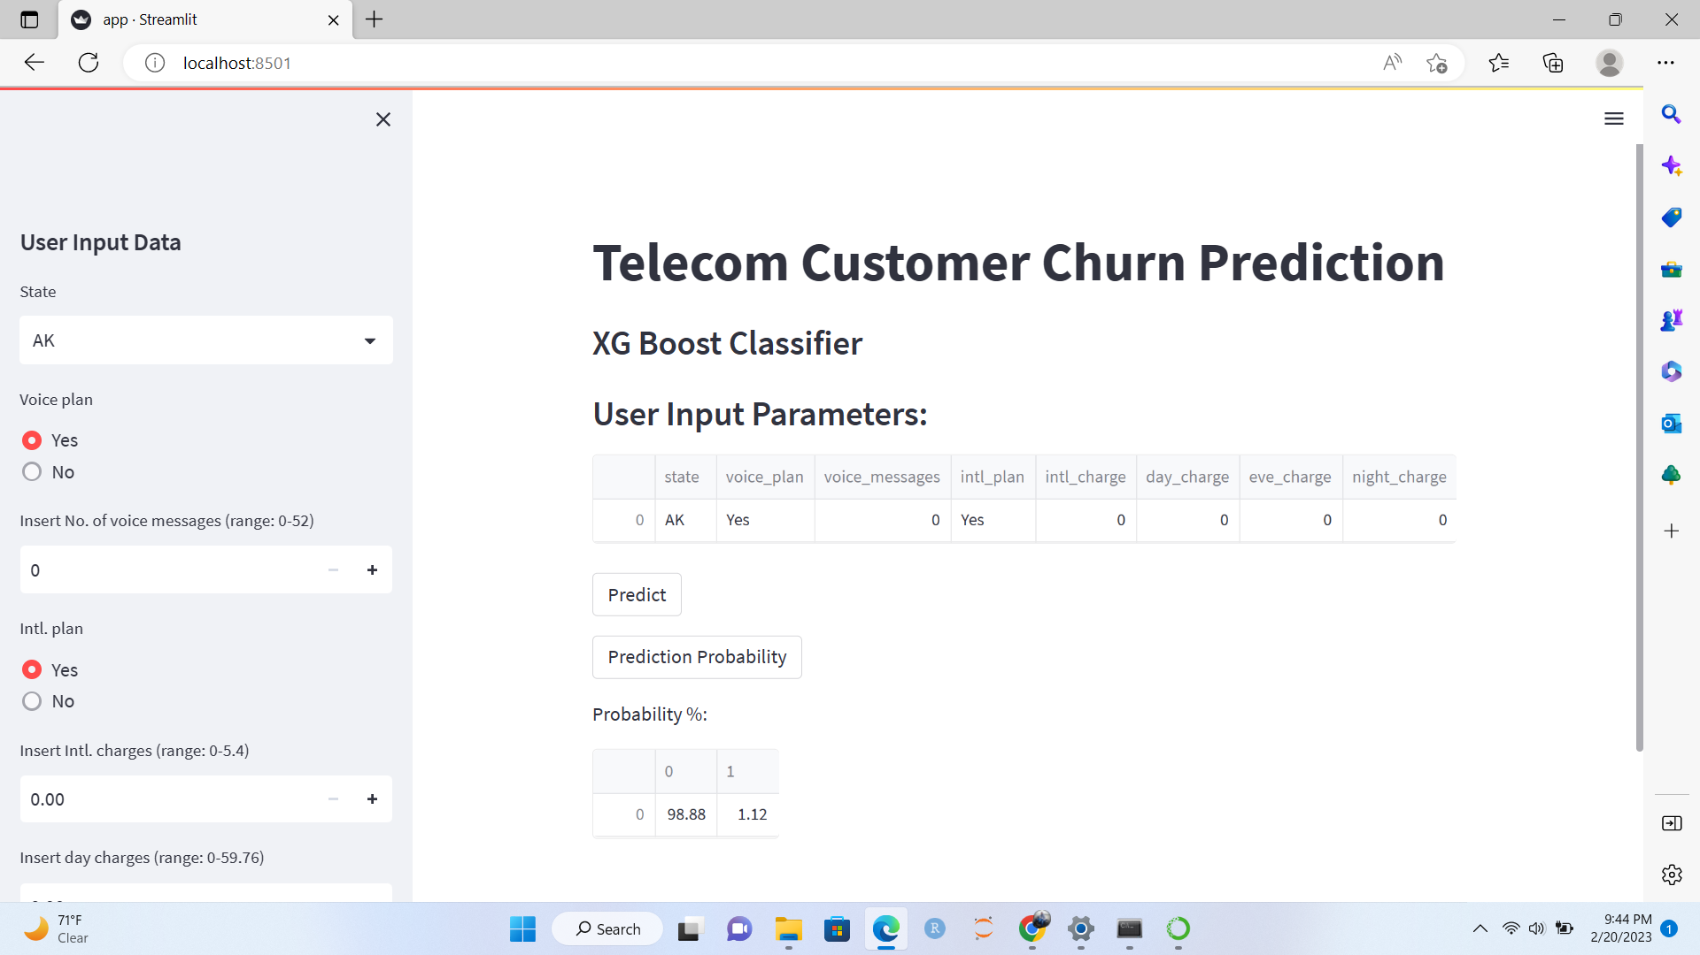


Slide 49



Slide 50
CHALLENGES
Data quality: As data includes issues such as missing or inconsistent data, outliers, and data entry errors. We handled these issues.
Imbalanced data: The number of customers who churn is relatively small compared to total number of customers. This can lead to imbalanced data, which can make it difficult to train a model that accurately predicts churn.
Model selection: There are many different algorithms and techniques that can be used to build predictive models, and choosing the right one for particular problem was challenging.
Some errors were faced while deploying the model using streamlit.

Slide 51
Thank you

